Slide 1
Putting Duct Tape on North America’s Last Energy-Only Market: ERCOT
Jay Zarnikau
Department of Economics, University of Texas at Austin
Chi-Keung Woo
Education University of Hong Kong
Shuangshuang Zhu
Frontier Energy, Austin, TX
Chen-Hao Tsai
MISO, Eagan, MN

Slide 2
The big question. . . .
In a very capital intensive industry with high fixed costs, will the use of short-run marginal costs to set prices provide sufficient revenues to provide a reasonable return to existing suppliers and provide sufficient incentive to attract new investment.
DuPuis (1844) and Hotelling (1938): Nope.
Joskow (2013): No, there is “missing money.”
Kielsing and Kleit (2009), Biggar and Hesamzaden (2014): Yes.

Slide 3
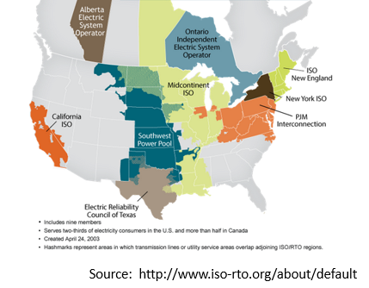
The Electric Reliability Council of Texas (ERCOT) Market
ERCOT serves 85% of the electrical needs of the largest electricity-consuming state in the U.S.
Over 77 GW of generating capacity.
Continued load growth.

Slide 4
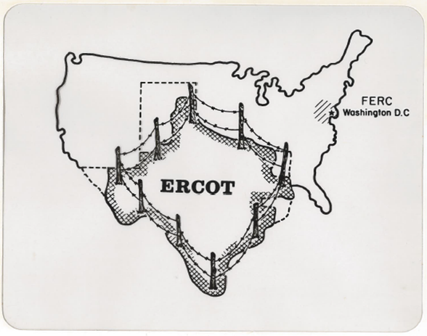
The Unique Status of the Texas Market
ERCOT is not connected to the rest of North America (at least not with A.C. ties).
Thus ERCOT is not involved in interstate commerce, and federal jurisdiction within the Texas electricity market is very limited.
An implication of this is that there is more state-level regulation over the wholesale market in Texas than in nearly any other state.

Slide 5
ERCOT’s Reserve Margin Target
The PUCT and ERCOT have adopted a target planning reserve margin of 13.75%.
Meeting the traditional 1-in-10 years Loss-of-Load Expectation standard might require a reserve margin around 16.75% (Astrapé, 2015) or 17.6% Northbridge, 2017).
Market forces alone are projected to yield an “economically-optimal” reserve margin of 9% and a market equilibrium reserve margin (additionally reflecting the original ORDC’s impact) of 10.25% (Brattle, 2018).

Slide 6
ERCOT’s Planning Reserve Margin Situation
The problem: Recent closures of aging coal plants.
Large coal plants retired in early 2018: the 1,865-MW Monticello plant; the 1,200-MW Sandow plant; and the 1,208-MW Big Brown plant.
The Gibbons Creek coal plant may be closed before the summer of 2019, while the 700 MW Okalunion coal plant is scheduled for closure in 2020.
Low natural gas prices have rendered the continued operation of many coal plants uneconomical.
The state’s renewable energy development has lowered wholesale market prices via the merit order effect.

Slide 7
Solutions to the Resource Adequacy problem
Capacity markets (PJM, New York, New England)
Resource adequacy requirements (MISO, SPP, California)
Let the forces of supply and demand work (ERCOT, Australia, Alberta)

Slide 8
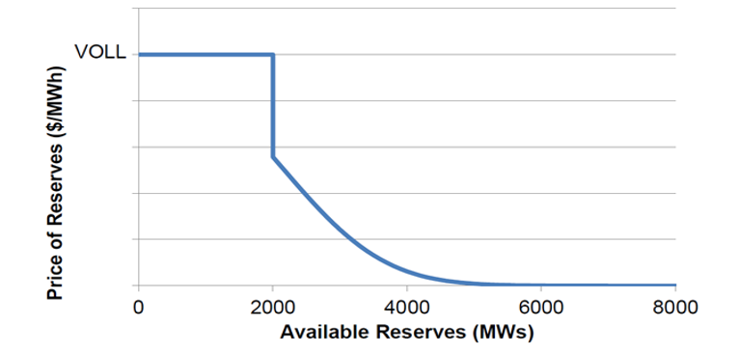
The Operating Reserve Demand Curve (ORDC)
ERCOT’s ORDC scarcity pricing mechanism results in a price adder to the LMP prices calculated by ERCOT’s SCED when operating reserves fall below a preset level.

Slide 9
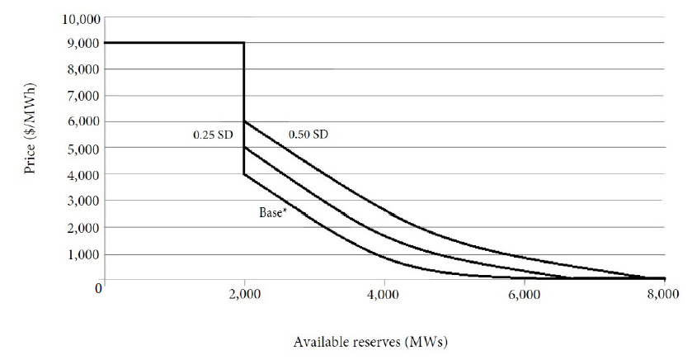
Shifting the ORDC
In January 2019, the PUCT approved a change in the ORDC curve based on a shift of 0.25 SD (standard deviations) for the summer of 2019.
An additional shift of 0.25 SD (for a total shift of 0.5 SD) is scheduled for 2020.
One SD is the standard deviation of the hour-ahead operating reserve forecast error’s distribution.

Slide 10
Back Cast Results

Slide 11
Back Cast Results

Slide 12
Will This Prove Sufficient?
A back cast of ORDC price adders indicates that shifting the ORDC would have greatly increased ORDC collections in 2018: A 9.5% increase in total electricity cost for 2018.
However, the ORDC shifts’ impact in the other three years would have been far smaller.
Had the redesigned curves been in effect in 2018, it might have indeed been effective in delaying some coal plant closures and attracting additional investment in generating capacity.
The same cannot be said about the other three years analyzed.
Such highly volatile ORDC impacts will continue to make generation investments in the ERCOT market quite a gamble.
Over the next couple of years of slim planning reserves, the ORDC’s impacts could be even greater than those back-casted for 2018.

Slide 13
This might prove to be a good short term fix. But, in the Longer Run
Low natural gas prices are expected to persist.
A review of planned resource additions for the ERCOT market suggests that Texas’s wind and solar generation is likely to increase, thus suppressing ERCOT’s wholesale market prices. Hence, duct-taping ERCOT’s energy-only market structure by modifying the ORDC may prove effective in mitigating ERCOT’s capacity scarcity in the near term.
But only time can tell whether this strategy will work in the long run.

