Slide 1
A Study on District Cooling System in APEC: Japan and Malaysia Cases
42nd IAEE International Conference Local Energy, Global Markets
A7 Integrated Systems – May 30, 2019
Edito Barcelona, Research Fellow
Asia Pacific Energy Research Centre

Slide 2
Outline
Background of the study
Why consider district cooling as an energy product?
Case studies
Japan
Malaysia
Proposed energy balance table
Situation and challenges in collecting district cooling data
District cooling data situation
Challenges in collecting DCS data
Way forward
Future research opportunities

Slide 3
Background of the study

Slide 4
Motivation/Objective
District cooling systems (DCS) are increasingly significant in a number of APEC economies; the space cooling data flow has not been clearly accounted for in energy statistics or energy balances.
Question raised in APEC EGEDA workshop, how district cooling data can be reported.
To assess DCS in selected APEC economies, and learn how the consumption in DCS are reported.

Slide 5
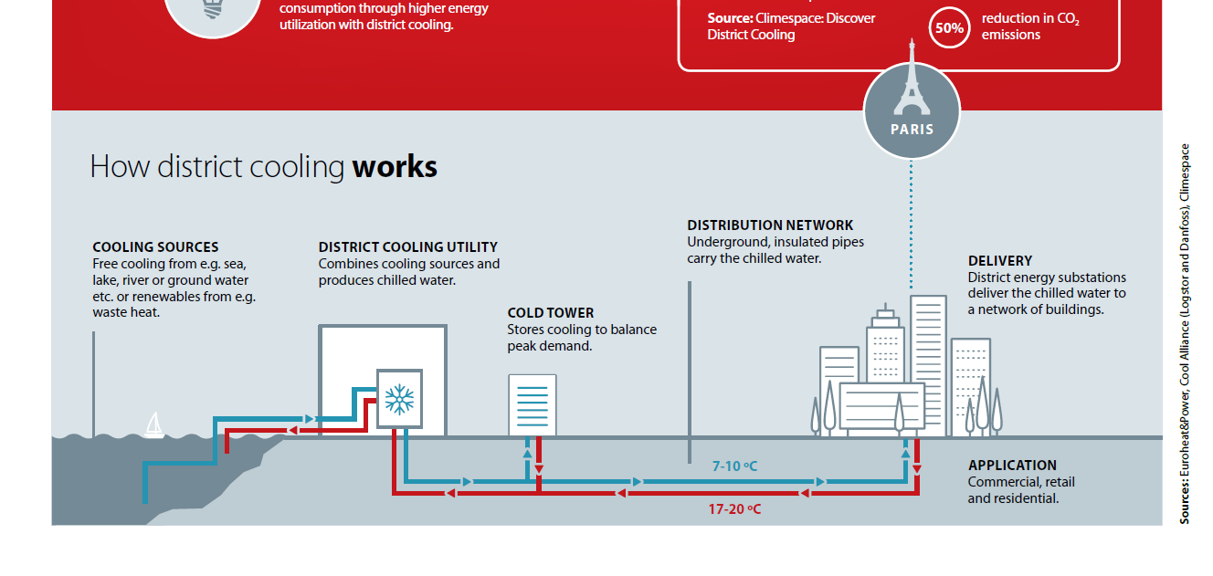
What is district cooling? (1)
District cooling
Source: Danfoss. (2016). How District Cooling Works. © Copyright Danfoss | Pravda.dk.
District cooling is the production and distribution of chilled water from a central source to facilitate air conditioning; done by producing chilled water at a central plant and then piping the water to customers through an underground insulated pipes network.
Data on energy inputs and output are measurable.
Deliveries to customers are also measurable.

Slide 6
What is district cooling? (2)
District heating
Source of image: Byun, Jae-Ki, et.al.; Study on the Development of an Optimal Heat Supply Control Algorithm for Group Energy Apartment Buildings According to the Variation of Outdoor Air Temperature. Energies. 2012, 5, 1688.
District heating is a transformation process that produces heat delivered to customers.
Energy input and output (hot water or steam) are measurable.
Products delivered to consumers are measurable.

Slide 7
Climate in APEC
RUSSIA
Subarctic/Humid continental. Humid with severe winter, no dry season, warm summer
NORTH AMERICA (CDA; USA)
Humid continental, humid subtropical, Mid-latitude steppe, Subtropical desert, equatorial rainforest
NORTH EAST ASIA
Humid subtropical. Hot summer. Average temperature of warmest months are over 72F (22C)
SOUTHEAST ASIA
Equatorial rainforest average monthly temperatures are greater than 64F (18C).
OCEANIA (AUS)
Subtropical desert. Average temperature is more than 64F (18C).
Source: Köppen-Geiger climate classification. (Kottek, Grieser, Beck, Rudolf, & Rubel, 2006)
DCS is not only popular in the tropics but also in other APEC economies during summer season

Slide 8
Possible DCS installations in APEC
Australia: 4 identified installations
China: more than 300 installations in the south of the economy
Hong Kong, China: developing 2 large DCS projects in the old airport area with cooling capacity of 284 MW
Korea: 27 installations supplying 1151 buildings
Malaysia: 27 plants
New Zealand: DCS serving residential and commercial buildings
Philippines: 2 identified large installations
Chinese Taipei: 2 companies operating DCS supplying large hospitals and buildings
Thailand: 6 big installations
There are known installations in Canada, Singapore and the USA.
Notes:
The largest district cooling capacity is in the United States, at 16 gigawatts-thermal (GWth), followed by the UAE (10 GWth) and Japan (4 GWth). In South Korea, district cooling more than tripled between 2009 and 2011 (Euroheat & Power, 2014).

Slide 9
2. Why consider district cooling as energy?

Slide 10
Two schools of thoughts
District cooling is an energy efficiency measure
District cooling is an energy product similar to heat

Slide 11
Arguments for cooling as an energy product (1)
The production and delivery of service of district cooling and district heating are similar
Energy is used to produce both chilled water and heat, and district heating is considered a transformation process, why not district cooling?
All DCS technologies need a large amount of energy input
Electric chillers requires electricity for cooling; free cooling (cold water from oceans, lakes, rivers or aquifers) uses natural gas and other fossil fuels; absorption chillers utilise surplus heat from waste incineration or industrial processes
Building efficiencies are measured by energy use intensity (EUI) in kWh/m²
Excluding chilled water will result in lower (EUI) and understate the actual energy consumption of the building

Slide 12
Arguments for cooling as an energy product (2)
Opens the possibility to be considered renewables
Huge potential for the use of free cooling in the production of chilled water; increasing the share of RE in the energy mix;
Will also encourage many economies to use free cooling resulting in lower carbon energy supply
Environmental impacts are normally reduced
Higher efficiency of district cooling compared to individual building cooling systems;
Refrigerants and other chemicals can be monitored and controlled;
Free cooling reduces energy requirement for chilled water production

Slide 13
3. Case studies
Japan and Malaysia

Slide 14
Benefits of DCS
Both economies identified the following benefits
Reduced capital cost in buildings in terms of avoided cost of chiller and other air-conditioning equipment
Reduced electricity usage and maintenance cost
Space savings due to avoided space requirement for chiller and air-conditioning installations

Slide 15
Case study (1)- Japan (a)
Expansion of DCS in highly developed/congested cities is difficult
Excavation for pipeline installation is nearly impossible as construction in roads are only allowed from late at night until just before sunrise
Expansion of DCS would be possible for new building complex constructions

Slide 16
Case study (1)- Japan (a)
Illustration in energy balance table, (2014, TJ)
Sector | Gas | Oil | Coal | Electricity | Others | Cold Energy | Heat Energy | Hot Water | Total
Transformation
CHP | -14 885 | -159 | 0 | -3 627 | -2 970 | 12 311 | 9 020 | 280 | -30
Final Consumption
Residential |  |  |  |  |  | 1 477 | 1 082 | 34 | 2,593
Commercial |  |  |  |  |  | 9 849 | 7 216 | 224 | 17,289
Source: Japan Heat Supply Association
The total heating and cooling energy reported were lumped together, i.e. heat reported by Japan includes both heating and cooling energy (chilled water).
Energy efficiency of heat production is overestimated if cooling is excluded;

Slide 17
Case study (1)- Japan (b)
Japan HSA balance (TJ)
Sources: Japan Heat Supply Association and IEA.
Quantity of heat in IEA and JHSA reports are the same
However in JHSA data, the quantity actually includes chilled water

Slide 18
Case study (2)- Malaysia
Illustration in energy balance table (MJ)
 | Gas | Oil | Coal | Electricity | Others | Cold Energy | Heat Energy | Hot Water | Total
Transformation
CHP | -165 632 |  |  | -10 596 |  | 117 961 |  |  | -58 267
Final Consumption
Residential |  |  |  |  |  | 0 |  |  | 0
Commercial |  |  |  |  |  | 115 601 |  |  | 115 601
Might have been reported as commercial sector consumption
Not reported
Source: GDCP, 2016
Malaysia’s report on DCS includes energy input (electricity and gas) and electricity as consumption (in KWhTR) ;
The district cooling plant consumed more than 90% gas and the rest electricity.;
Commercial consumption maybe over reported;
Large amount of cooling consumption was not accounted for.

Slide 19
Proposed energy balance table
Supply
Transformation and Energy sector
Final Consumption
Chilled water should form part of heat (energy products), and district cooling plants will be included in the transformation flow to balance.
Notes:
Self sufficiency: Production/TPES
Self sufficiency is how much energy demand is met by production. Are you able to produce what you consume?
If it is greater than 100%, the economy is self sufficient

Slide 20
4. Situation and challenges in collecting district cooling data

Slide 21
District cooling data situation
In China and Korea, district cooling data are reported as part of “heat” like in Japan
Data are not collected but maybe available:
● Australia ● Philippines
● Canada ● Singapore
● China ● Chinese Taipei
● Hong Kong, China ● Thailand
● Malaysia ● USA
Hope to collect data in Canada; Hong Kong, China; the Philippines, and US

Slide 22
Challenges in collecting district cooling data
District cooling is not yet a regulated industry in economies that just started this kind of business making data collection not as easy as in the regulated activities
Malaysia; Philippines; Singapore; Thailand
APEC needs to prepare a document that would contain information on district cooling technology and methodology on related data that should be collected such as:
Fuel input
Use of free cooling, such as utilisation of water from deep sources, snow storage, etc.
Chilled water output
Chilled water delivered to customers
Lastly, “should free cooling be considered renewable energy?”

Slide 23

Way forward
Collect data in other APEC economies; i.e: Canada; Hong Kong, China; and USA;
Identify major cities in APEC with potential to use free cooling;
Estimating energy savings in the utilization of free cooling;
Though cases maybe limited, complete the study by the end of the year;
Continue sharing information with IEA, UNSD and other related fora.

Slide 24
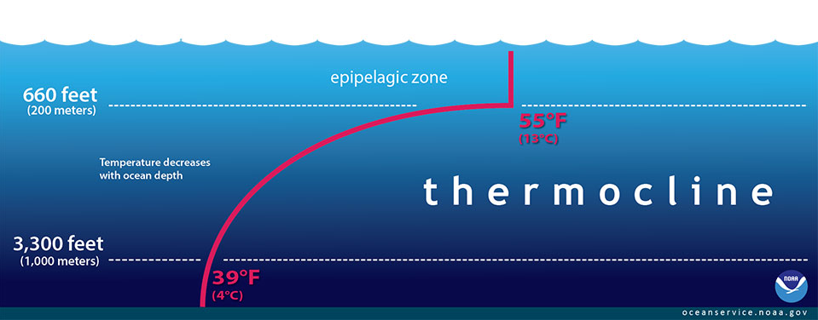
Future research opportunities
Potential for utilization of water from deep source in APEC
Free cooling from just 1,000 meters below sea surface
Source: National Ocean Service, National Oceanic and Atmospheric Administration, U.S. Department of Commerce. https://oceanservice.noaa.gov/facts/thermocline.html

Slide 25
Free cooling potential in APEC

Slide 26
Energy savings from free cooling
The relationship between heat and temperature change is expressed in the form below:
𝑄=𝑀∗𝐶∗Δ𝑇
Q = rate of heat transfer (joule)
M = mass flow rate (kg)
C = specific heat of water (joule/kgºC)
ΔT = change in temperature of water (ºC)
From the above equation, Q is proportional to M and ΔT
If ΔT can be reduced to as small as possible, Q can also be reduced.
Free cooling can reduce ΔT to as low as zero.

Slide 27
Thank you for your kind attention.

