Slide 1
Impact of natural gas consumption on various air pollutants：evidence from china's cities
Dongou Hu
School of Economics and Management,
China University of Petroleum, Beijing
May 31th,2019

Slide 2
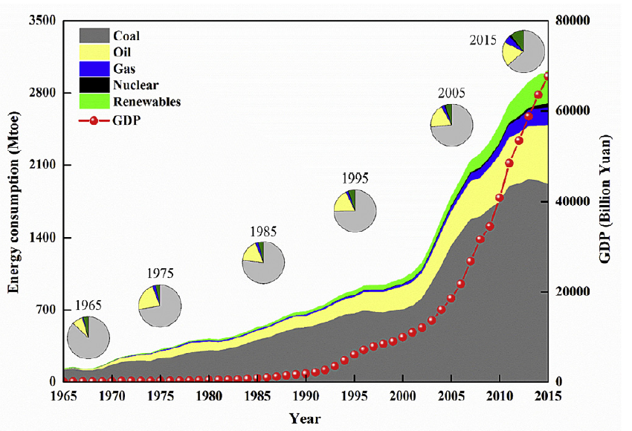
Total energy consumption and GDP from 1965 to 2015 in China.
Data source: BP,Statistical Review of World Energy 2016, and NBS China Statistical Yearbook 2015.

Slide 3
The annual net growth rate of natural gas consumption in China was only 12.2 billion cubic meters, or about 6%, from 2014 to 2016.
The natural gas consumption of China saw explosive growth in 2017-2018.
To reduce environmental pollution and adjust the energy consumption structure, natural gas has become an effective alternative to other fossil fuels (such as coal and oil) in China.
GDP
(100 million yuan)
Per capita GDP
( yuan)
Gas consumption
(100 million m³)

Slide 4
It is very important to investigate the impact of natural gas consumption on air pollutants in terms of four typical pollutants emissions in China
sulphur dioxide (SO2)
nitrogen dioxide (NO2),
particles with diameters of 10um or less (PM10)
fine particulate matter (PM2.5)

Slide 5
Environmental Kuznets curve (EKC);
Generalized method of moments (GMM)
Influences
Marginal effect
01
02
ln(GRP_{it})=μ_{i}+δ_{t}+α₀ln(GRP_{it-1})+α₁NG_{nt}
+α₂urban_{it}+α₃industry_{it}+ε_{it}
Direct impact
Indirect effects
ln(P_{it})=θ_{i}+γ_{t}+ln(P_{it-1})+β₀ln(GRP_{it})+β₁Eln²(GRP_{it})
+β₂NG_{nt}+β₃urban_{it}+β₄industry_{it}+υ_{it}
+Per capita green area ？
+Traffic industry factors ？
Data source:China's Environmental Statistics Yearbook and Provincial and Municipal Statistical Yearbook Data from 1998 to 2017

Slide 6
Aims
A better understanding of the drivers of changes in air pollution.
For policy makers and government officials to formulate long-term and short-term policies to combat air pollution.
For exploring possible mitigation approaches.

Slide 7
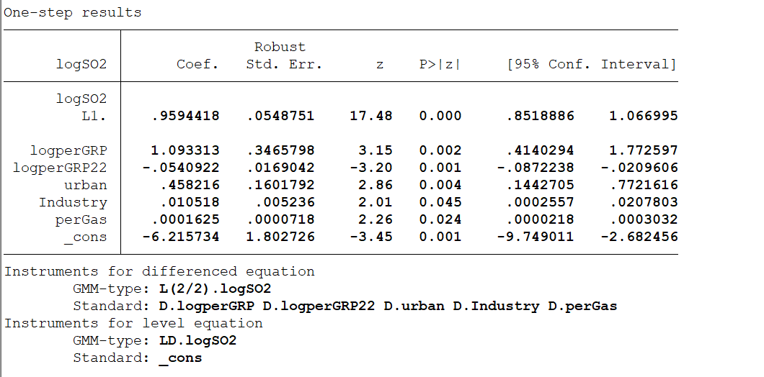
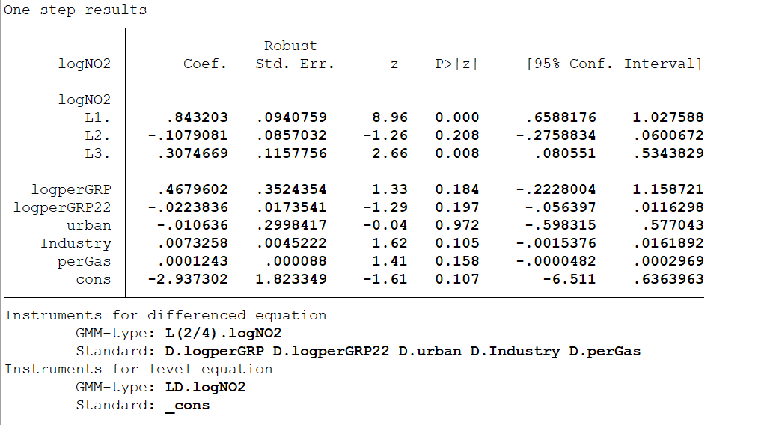
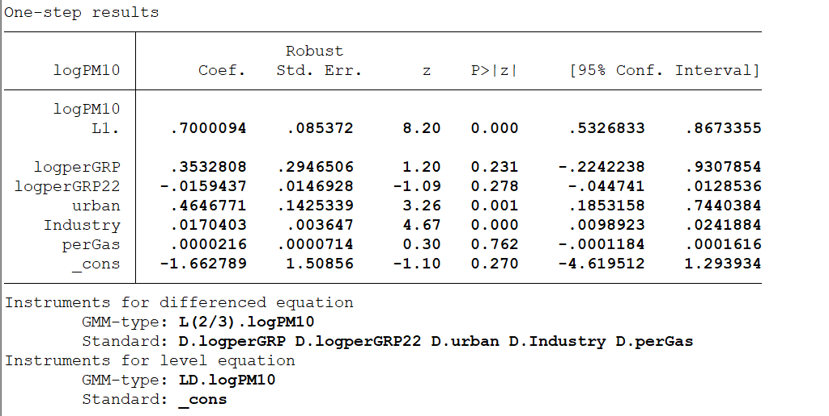
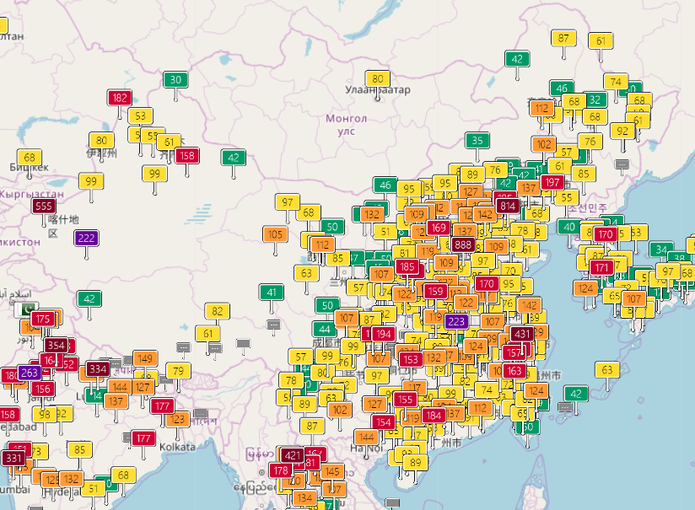
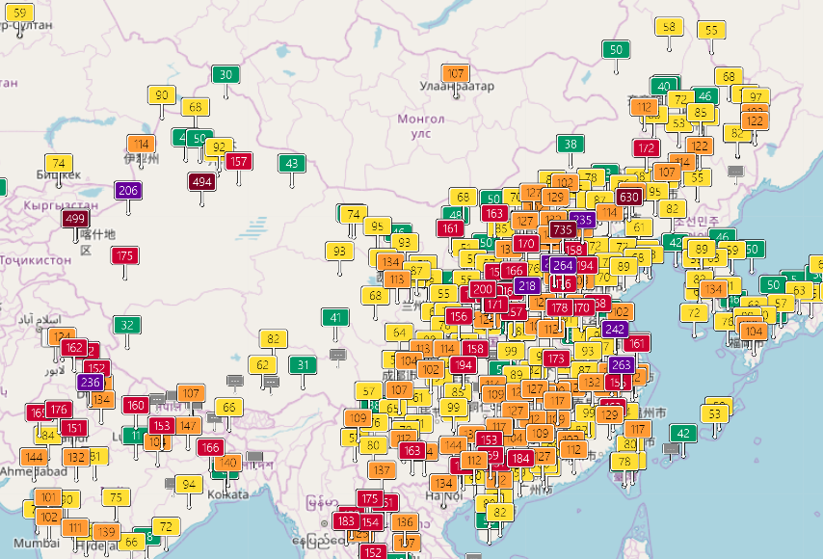
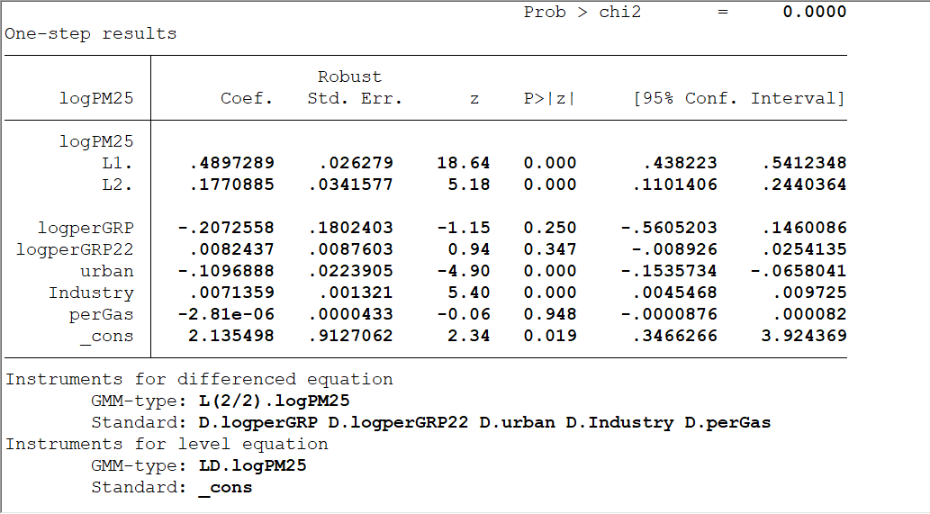
Source: China Air Pollution, Real-time Air Quality Index Map

Slide 8
Conclusion
1
The problem of air pollution in China has become one of the most serious environmental problems.
2
In the long run, there is an EKC curve relationship between air pollution emissions and per capita GRP; and different regions present different EKC curve relationships.
Respirable particulate matter is present in many parts of mainland China, which is very common in the north. Sulfur dioxide pollution is also a major and serious pollution. The dust pollution in the northwest is very serious.Particulate matter in the north often forms a wide range of ash weather.
3
4
In the south, because the soil is acidic, the emission of sulfur dioxide and the emission of nitrogen oxides are also very large, and the area of acid rain is affected by about one-third of the country.
5
Natural gas consumption can effectively replace energy consumption such as coal.

Slide 9
Energy policy advice
1
Different areas of pollution, regional air quality control
As the SO2 and PM2.5 are significantly influential to people s health, the government has previously taken certain actions and published related regulations to improve the air quality.
2
Energy consumption structure adjustment
Since the higher ratio of natural gas consumption could reduce the emissions of air pollutions, enlarging the proportion may be helpful to the emission reduction.
3
Cleaning is the core value of natural gas, and the national strategy of clean energy should be firmly used to optimize energy structure and improve air quality.

Slide 10
Future
The growth of natural gas consumption in 2018 is still highly dependent on the “coal to gas” project. As a continuation policy of the Air Pollution Prevention and Control Plan, in July of the same year, the State Council issued the “Three-Year Action Plan to Win the Blue Sky Defence War” (hereinafter referred to as the “Three-Year Blue Sky Action Plan”), and proposed a new air governance target, “Coal Reform”. Gas is also an important means of realization.
It is planned to set 2021 as the year of ending, then after 2021?

Slide 11
THANKS

