Slide 1
June, 1st 2019
How to model the benefits of behavioral shifts in the transportation sector?
Marianne Pedinotti-Castelle^{†1}, Kathleen Vaillancourt², Pierre-Olivier Pineau³ and Ben Amor¹
†Marianne.Pedinotti-Castelle@USherbrooke.ca
¹ LIRIDE, University of Sherbrooke
² ESMIA Consultants, Montreal
³ HEC Montreal, Chair in Energy Sector Management

Slide 2
1. Context
Sources : MDDELCC 2016, ECCC 2016

Slide 3
1. Context
In the transportation sector
Current suggested solution in Quebec : Electrification
Unsolved issue :
Is this sufficient to reach the goal?
What could be the consequences?
There are no energy and cost assessment of such solution, no benchmark against alternative solutions

Slide 4
1. Context
What we know on the electrification of the transportation sector
Batteries costs are expected to decrease and gasoline prices to increase
Are people willing to invest in electric vehicles?
Depending on the consumer behavior

Slide 5
1. Context
What we know on the electrification of the transportation sector
2018 discounted investment costs
Fixed O&M costs
Variable O&M costs
ICE PHEV EV
ICE PHEV EV
ICE PHEV EV

Slide 6
1. Context
What about non technological = behavioral solutions ?

Slide 7
2. Scenarios
Electrification
After 2025, 100% electrical sales
226,000 sales/year and fleet of 3.6 M cars in 2015 = 5% electric cars in 2025; 26% in 2030; 100% in 2050
166 000 sales/year light trucks and 1.6 M trucks = 8.2% in 2020; 44.7% in 2030; 100% in 2050
Carpooling scenario = 58.24% demand reduction
Limitation of trips of less than 1km: 20% reduction in total demand
From 1 to 11km: double the number of passengers = 3 people per car = 26.6% reduction in demand
From 12 to 50km: double the number of passengers = 3.2 people per car = 10.1% reduction in demand
From 50 to 100km: double the number of passengers = 3.6 people per car = 1.1% reduction in demand
More than 100km: +1.5 passengers = 3.6 people per car = 0.44% reduction in demand

Slide 8
2. Scenarios
Assumptions :
No cost limitation
No limitation of GHG emissions
No constraints on renewable electric capacity

Slide 9
2. Scenarios
Large cars – ICE
Small cars – ICE
Light trucks – ICE
Large cars – PHEV
Small cars – PHEV
Light trucks - PHEV
Large cars – EV
Small cars – EV
Light trucks – EV

Slide 10
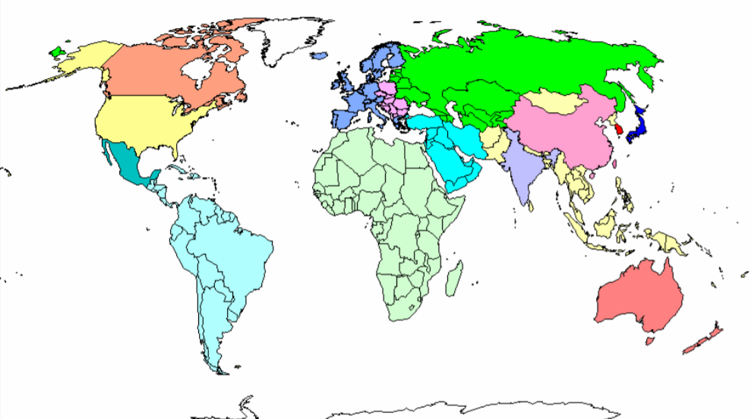
3. The model
North American TIMES Energy Model (NATEM)- Quebec
TIMES Energy Model
15 regions ; 70 countries

Slide 11
3. The model
North American TIMES Energy Model (NATEM)
Optimization of the cost of energy systems
Price
Indicators: economic
optimal mix of technologies and fuels at each period
Environmental
associated emissions
Demand curve
Technologies (efficiency, costs)
Demand
Constraints
Supply curve
Equilibrium
PE
QE
Quantity

Slide 12
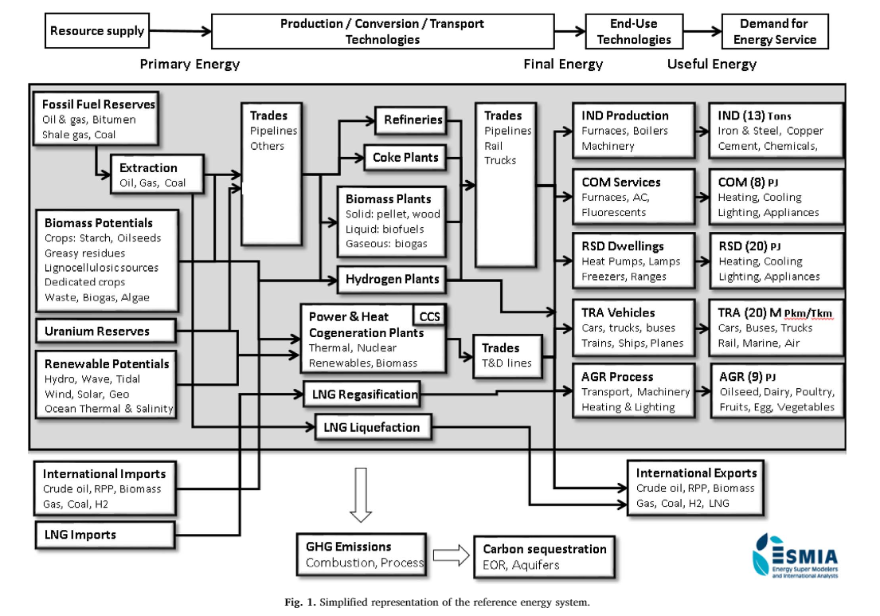
3. The model
More than 4,500 technologies
Bottom-up model

Slide 13
4. Preliminary results
Technologies can be sufficient...
Carpooling
Electrification

Slide 14
4. Preliminary results
But at the cost of an increase in electricity consumption...
Carpooling
Electrification
10 TWh ~

Slide 15
4. Preliminary results
And an increased expenditure for the consumers …
Carpooling
Electrification
Carpooling
Electrification
Note
Current household expenditures are 9,000-15,000M$/year (2016) (Institut de la statistique du Québec, statistical addendum)
Cost of the energy transition in Quebec ~ 100 billion $ in 2030

Slide 16
Conclusion
The benefits of behavioral shifts could be significant in a possible transition to a low-carbon economy.
Simple behaviours can have quantifiable impacts :
Significantly reducing greenhouse gas (GHG) emissions by limiting investment by several billion dollars
Limiting electricity consumption by several GWh per year
Depending on different consumers behaviors such as
The willingness to pay (discount rate) or
The property (car lifetime)…

Slide 17
Scenarios
Gasoline
Biofuels
Diesel
Electricity

