Slide 1




CCSTT:
A Business Case for Microgrids with Solar to EV Charging
M.K. Anand
Balpreet Kukreja
Bernardo Ruz

Slide 2
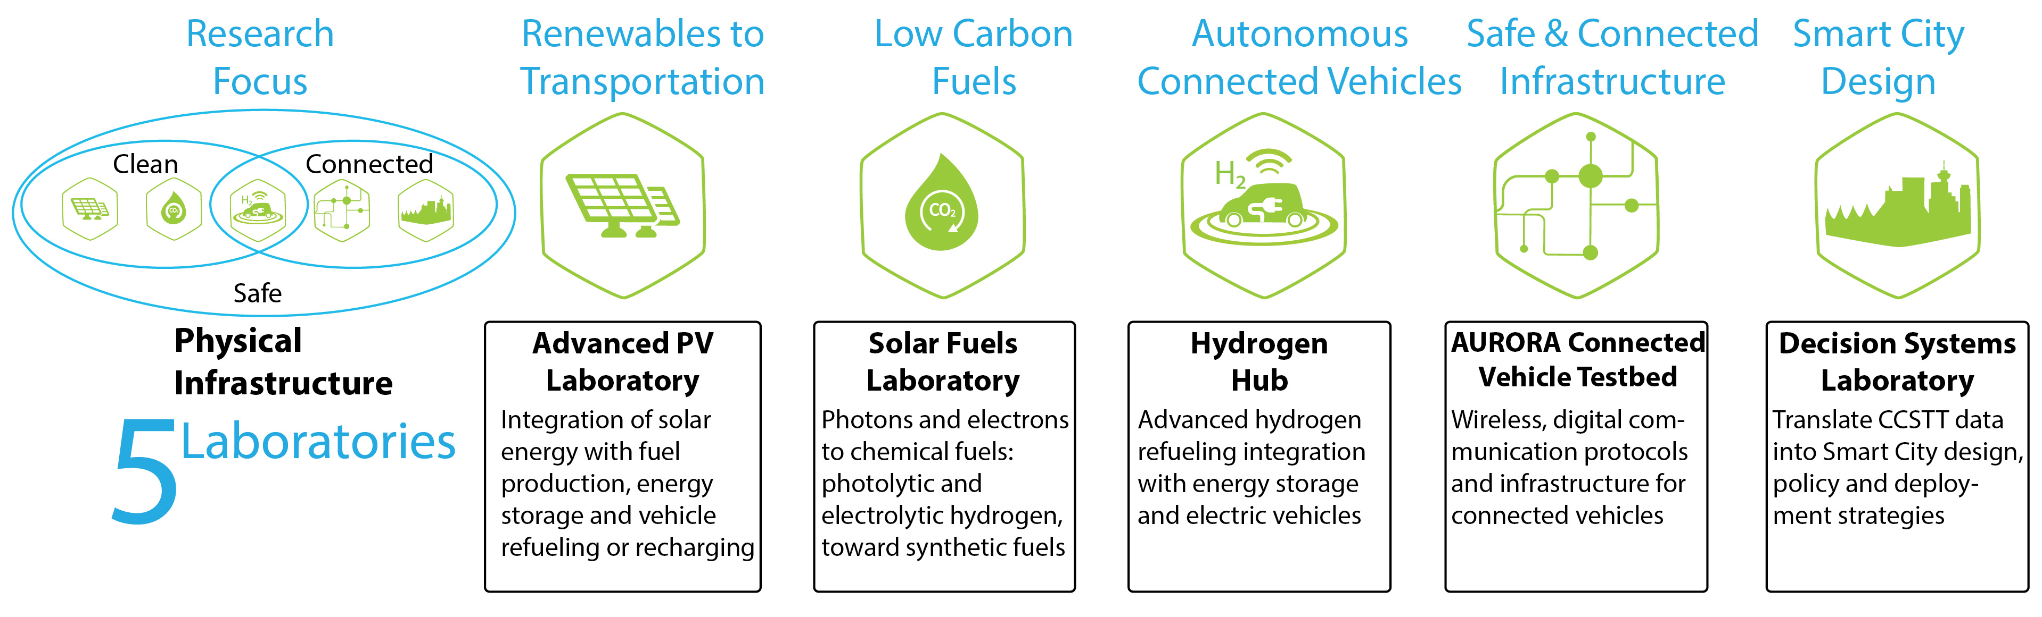
CCSTT
Clean Connected Safe Transportation Testbed
Notes:
This is the dream of the Clean Connected Safe Test bed - It’s a living Laboratory being developed by the Clean Energy Research Center right here at UBC linking transportation, energy, and communication to urban design. It has 5 components: Renewables to Transportation, Low Carbon Fuels , Autonomous Connected vehicles, Safe and Connected infrastructure and Smart City design.

Slide 3
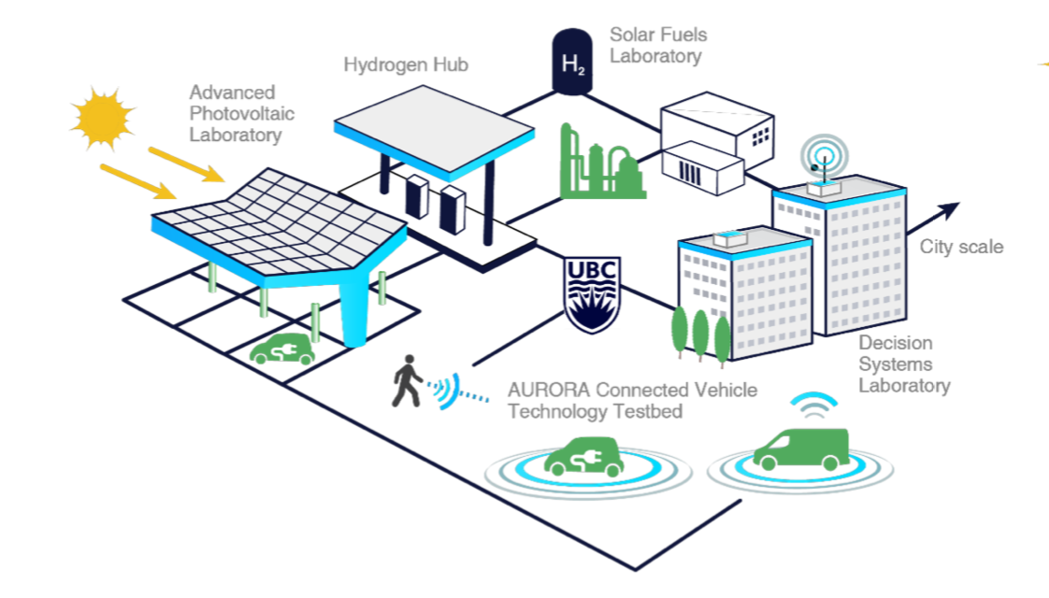
CCSTT
Clean Connected Safe Transportation Testbed
Notes:
And this is what it might look like all together. This is our component - the Advanced Photovoltaic Lab which has a goal of reducing the carbon footprint of our fleet at UBC and supporting zero emission vehicles by providing low carbon fuels.

Slide 4
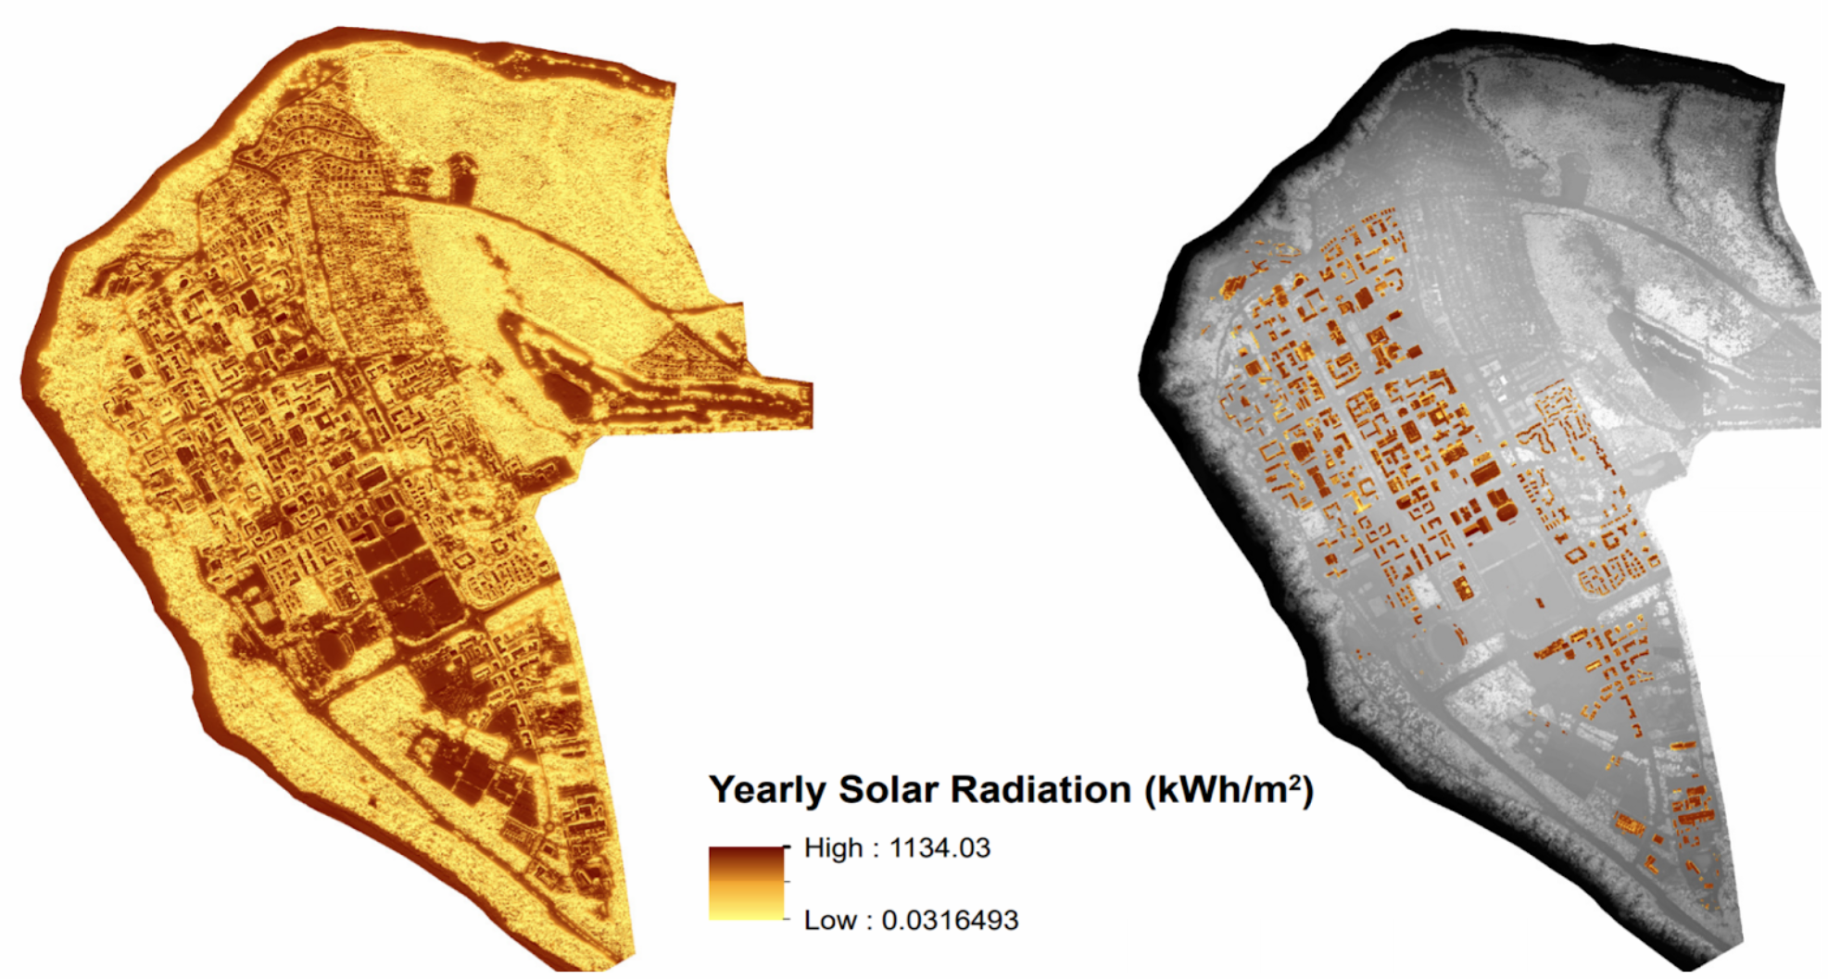
Solar Potential
Notes:
We looked at the solar potential at the University for the best available locations for Solar. One of the stipulations of the funding we received from the Government was that we incorporate this microgrid on top of a parkade to integrate the energy with vehicles that might need charging. We found that the Thunderbird parkade has an excellent solar profile. We performed analysis through RetScreen, consulted with local solar providers and found out that we have nearly 10,253 m2 area and 1MW of available solar generation potential on top of Thunderbird parkade.

Slide 5
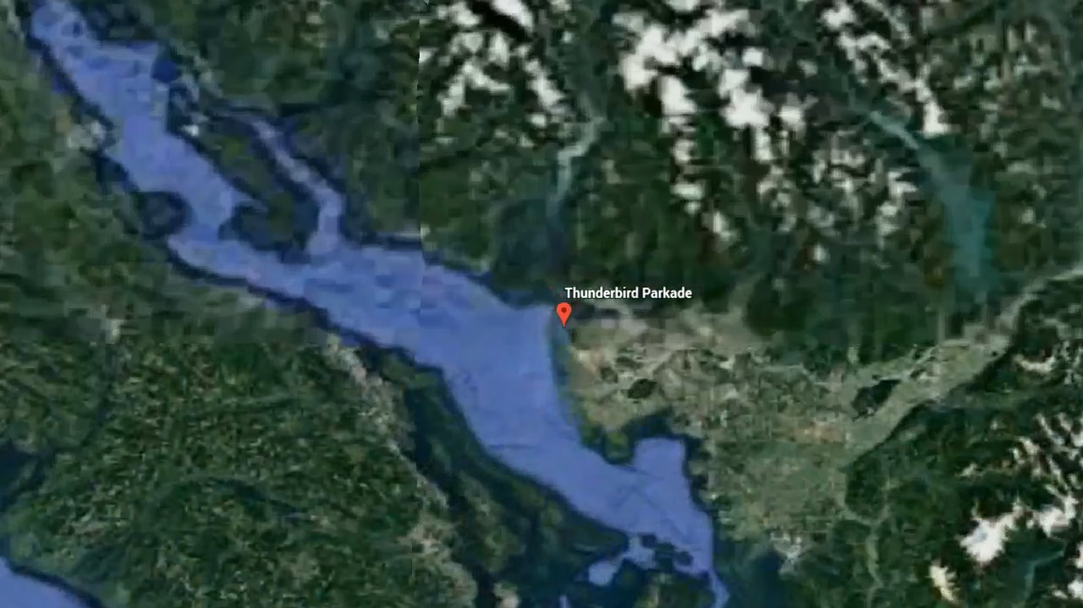
Notes:
We looked at the solar potential at the University for the best available locations for Solar. One of the stipulations of the funding we received from the Government was that we incorporate this microgrid on top of a parkade to integrate the energy with vehicles that might need charging. We found that the Thunderbird parkade has an excellent solar profile. We performed analysis through RetScreen, consulted with local solar providers and found out that we have nearly 1MW of available solar generation potential on top of Thunderbird parkade.

Slide 6
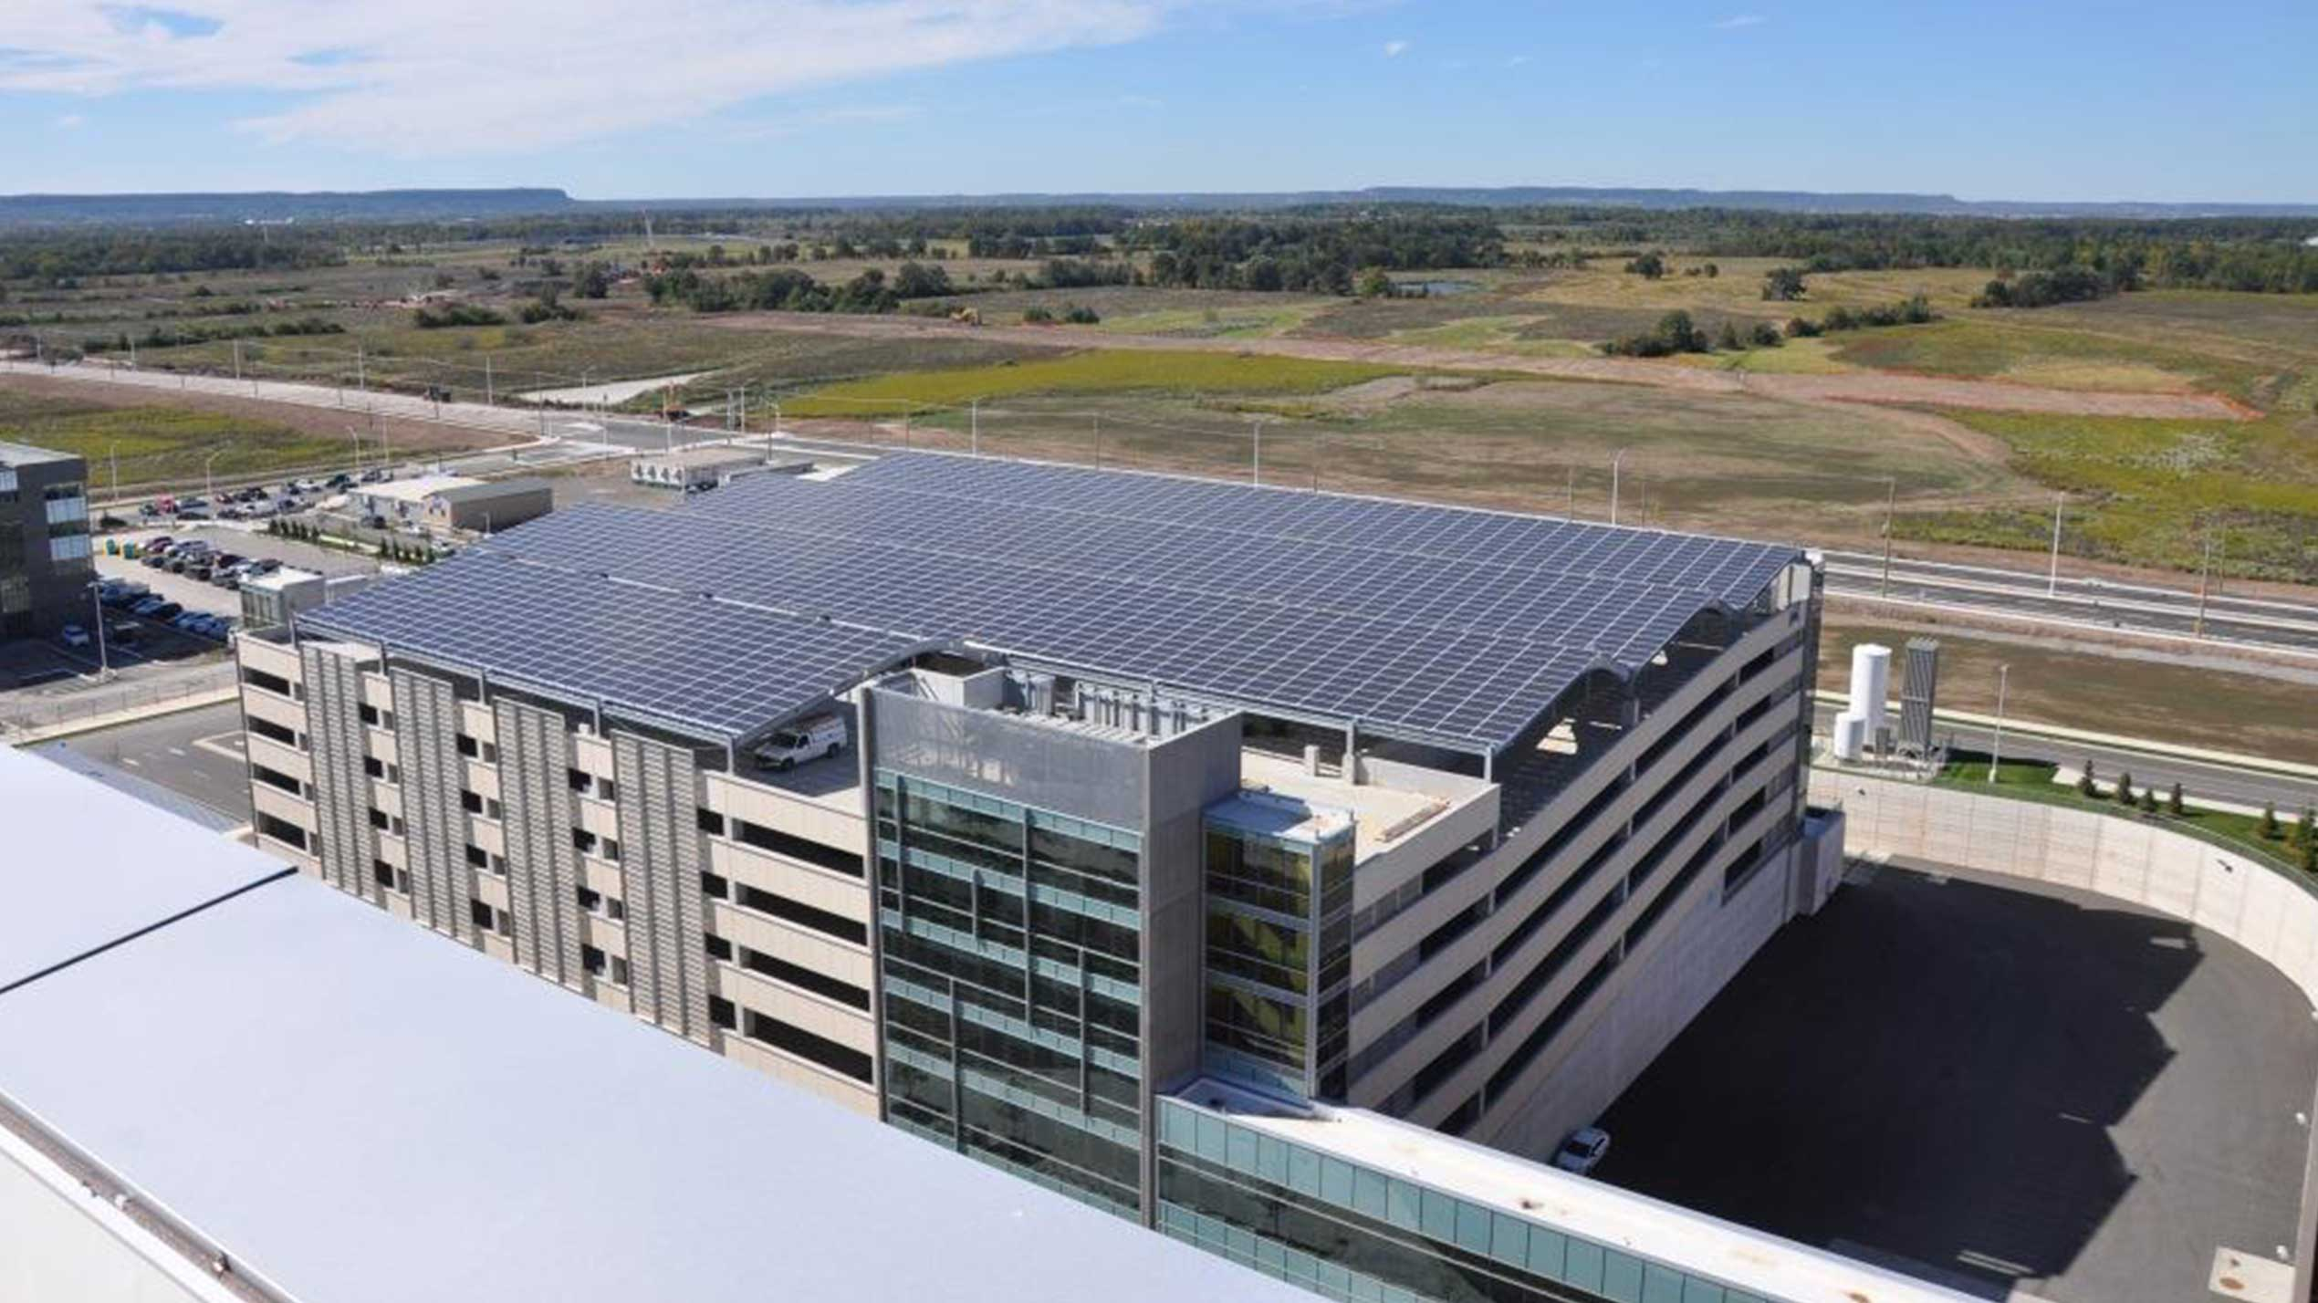
Solar Potential
Notes:
Photoshop edit with solar canopy on top of thunderbird

Slide 7
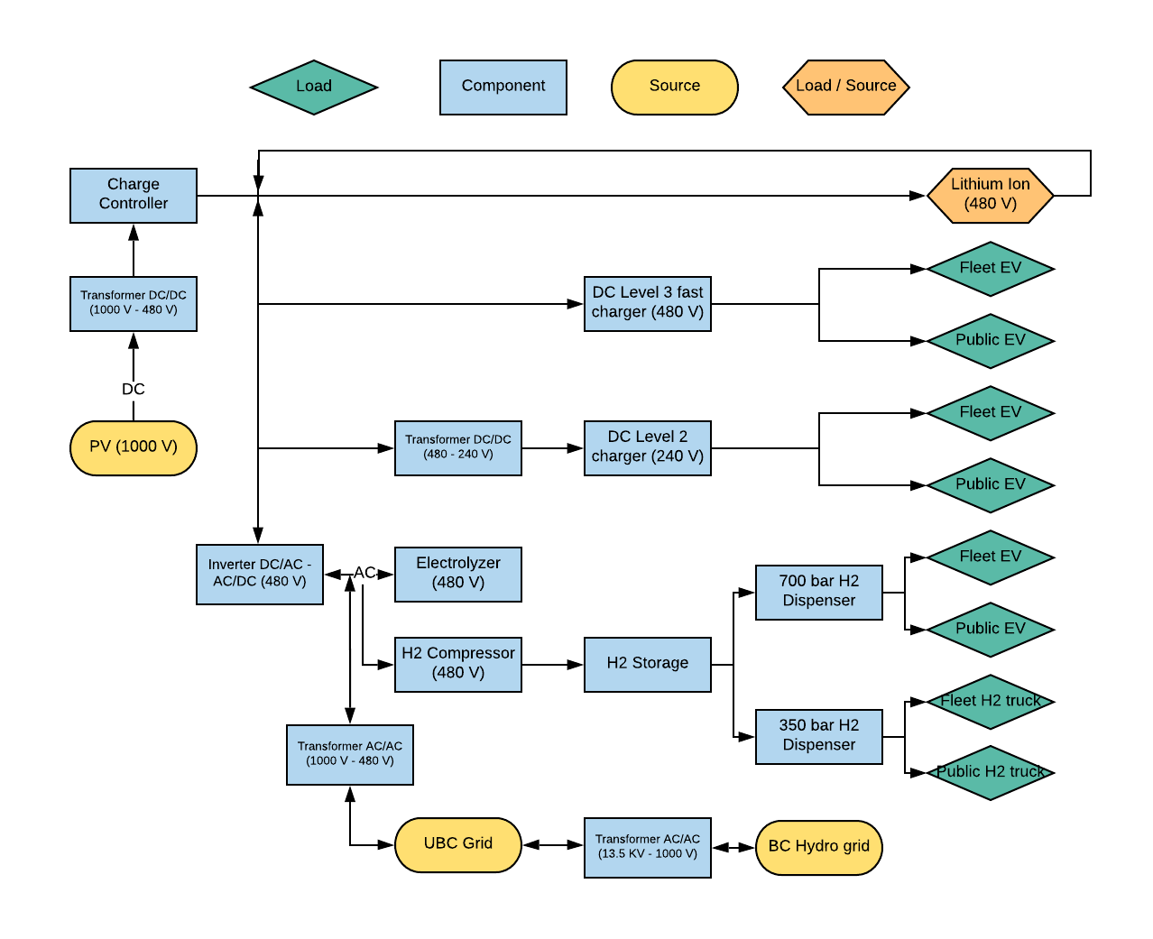
Microgrid Components
Notes:
So that is the solar component. All the other components of the microgrid are shown here, from the transformers, inverters to EV chargers, storage components, hydrogen generation, refuelling station and connection back to the grid. We developed a logic framework for where the electricity would flow under different use cases. When the sun shines, the energy would first be sent to EV charging if there is need, if not, it gets sent to produce hydrogen or EV storage depending on if there is a need to refill our hydrogen tanks. If there is no solar energy available, we draw from the grid.

Slide 8
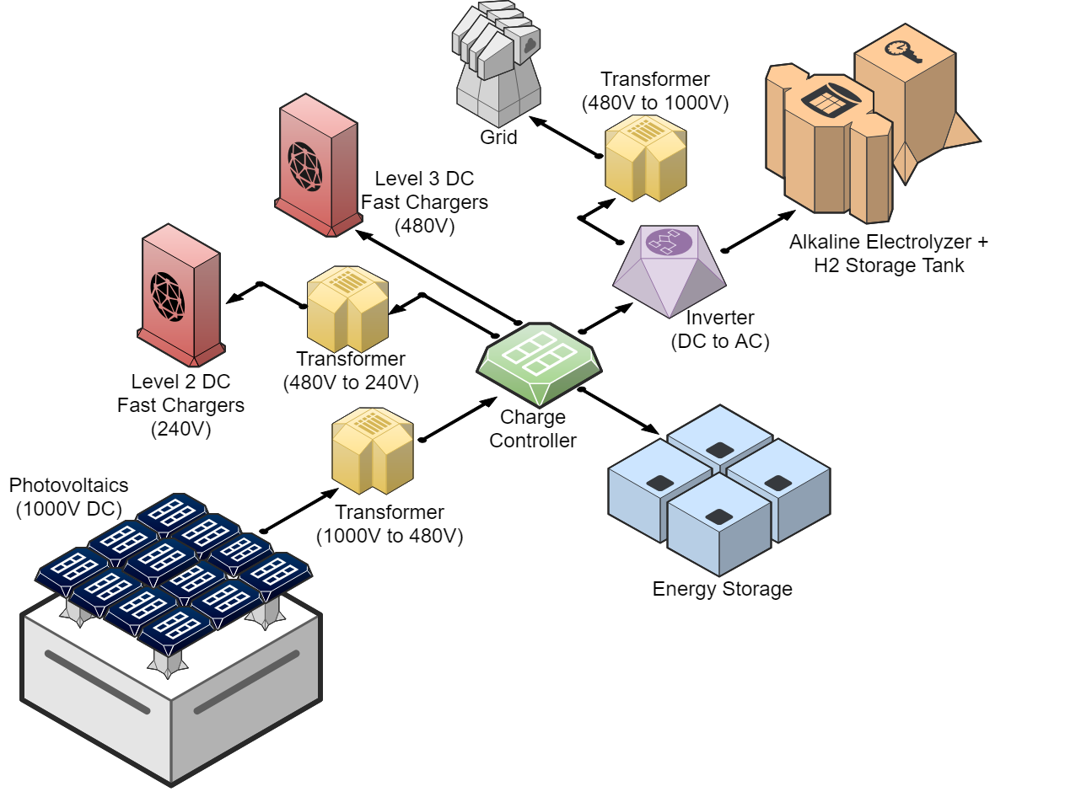
Microgrid Components
Notes:
So that is the solar component. All the other components of the microgrid are shown here, from the transformers, inverters to EV chargers, storage components, hydrogen generation, refuelling station and connection back to the grid. We developed a logic framework for where the electricity would flow under different use cases. When the sun shines, the energy would first be sent to EV charging if there is need, if not, it gets sent to produce hydrogen or EV storage depending on if there is a need to refill our hydrogen tanks. If there is no solar energy available, we draw from the grid.

Slide 9
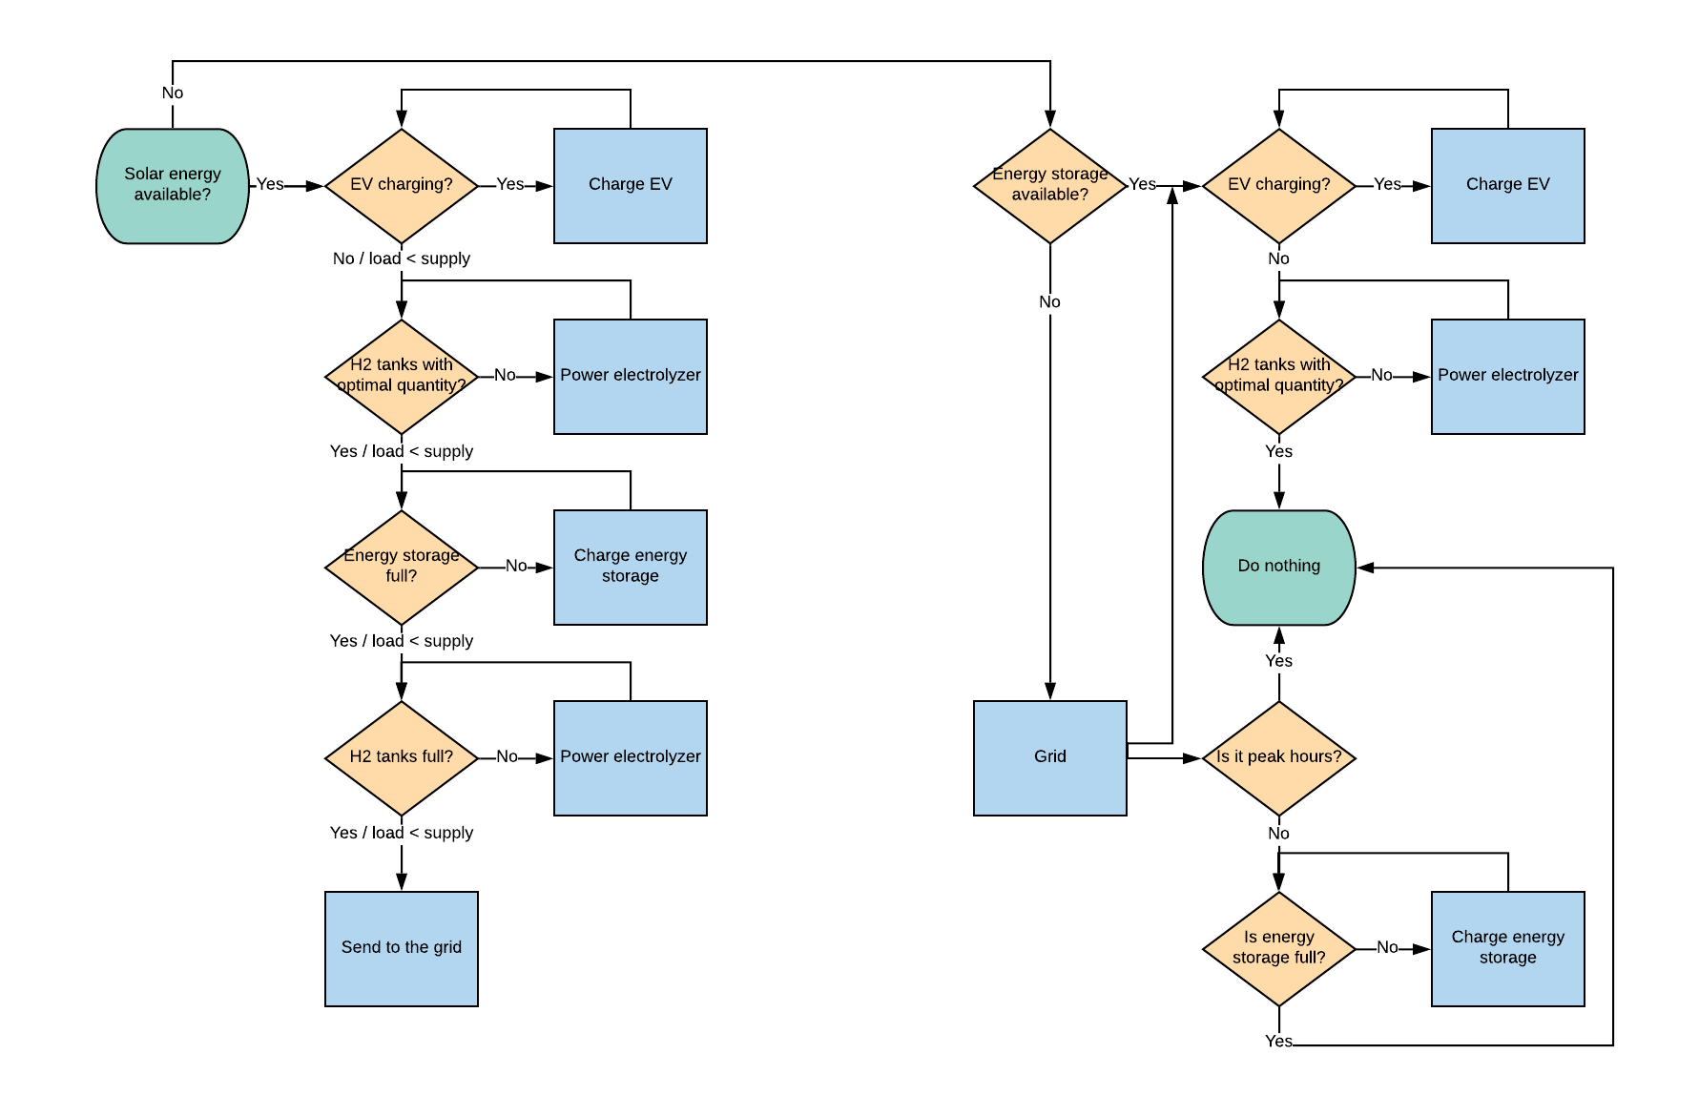
Microgrid Components
Notes:
So that is the solar component. All the other components of the microgrid are shown here, from the transformers, inverters to EV chargers, storage components, hydrogen generation, refuelling station and connection back to the grid. We developed a logic framework for where the electricity would flow under different use cases. When the sun shines, the energy would first be sent to EV charging if there is need, if not, it gets sent to produce hydrogen or EV storage depending on if there is a need to refill our hydrogen tanks. If there is no solar energy available, we draw from the grid.

Slide 10
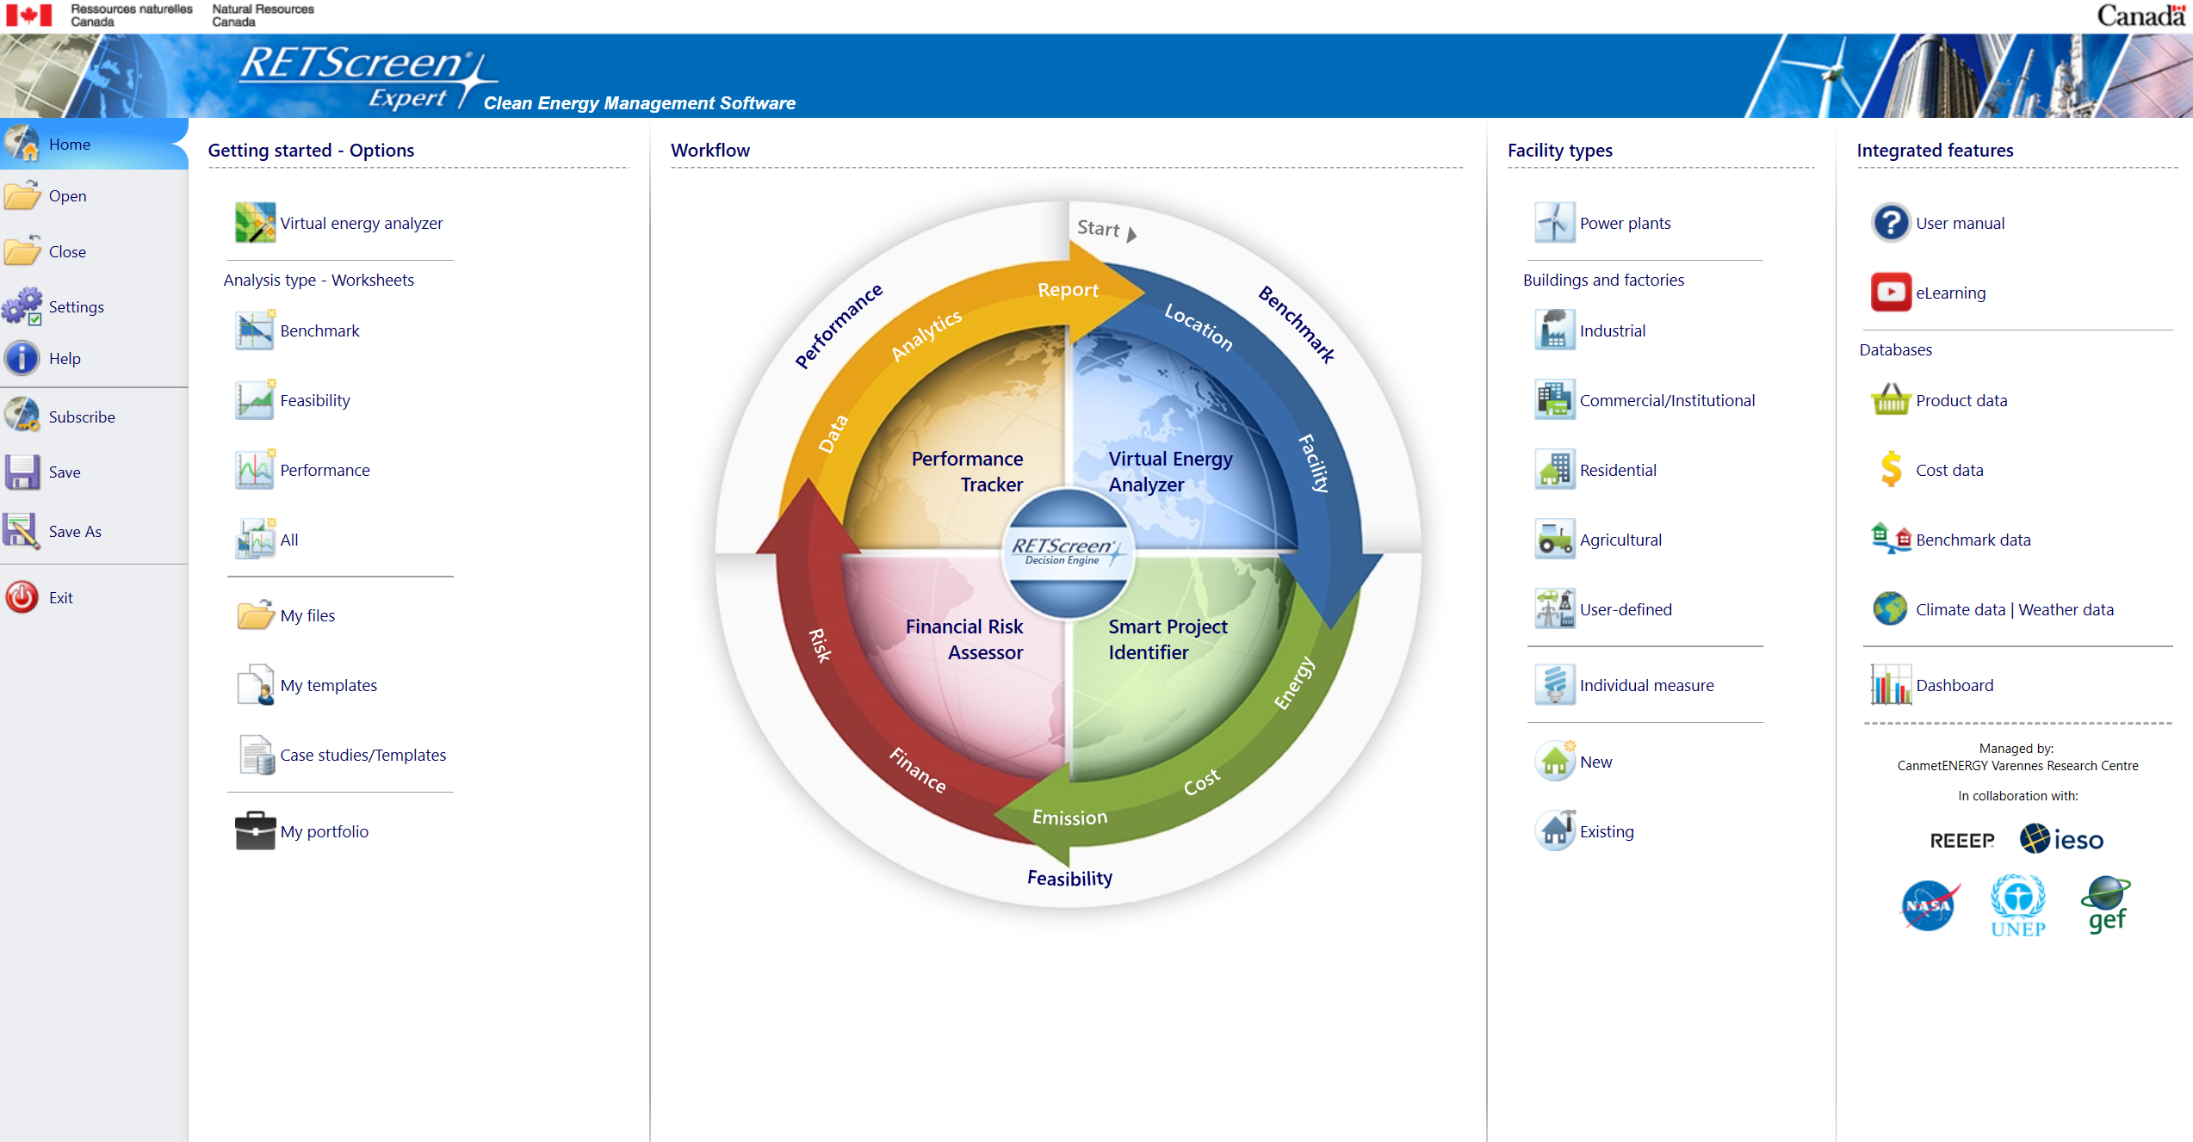

Model
Notes:
Now we had to build a model where we put this logic to work and started with the software RetScreen quickly realized its limitations and moved on to Homer Pro – an energy modelling software. But we couldn't adjust the internal logic of how energy flows between its components so had to build our own…

Slide 11
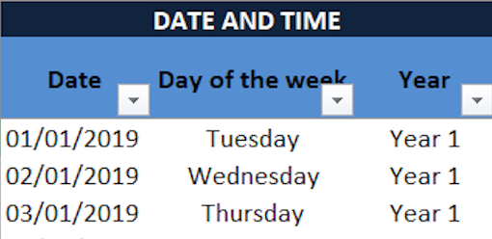
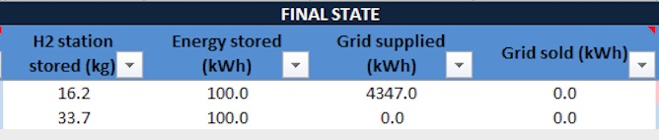
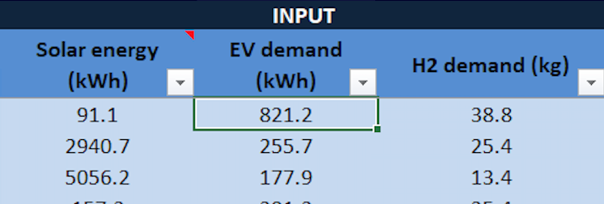
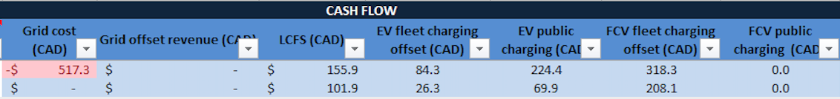
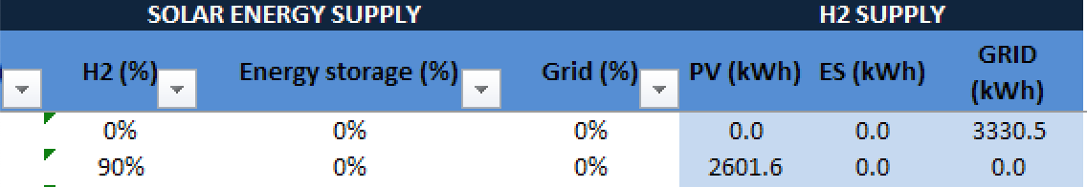
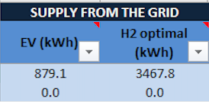
Model
Notes:
It started out with hourly behaviour of the microgrid for 40 years – From the Solar and grid energy coming in, The EV and Hydrogen loads, the state of charge in the battery at any given time, the hydrogen levels in our tank and how much all of this is is costing us and how much money we are making. That’s a lot of data 350,000 rows of data. The model got heavy so we tested to see the difference in numbers with a daily model and it didn’t too much of a difference so we scaled it down to every day for 40 years. Still substantial.

Slide 12
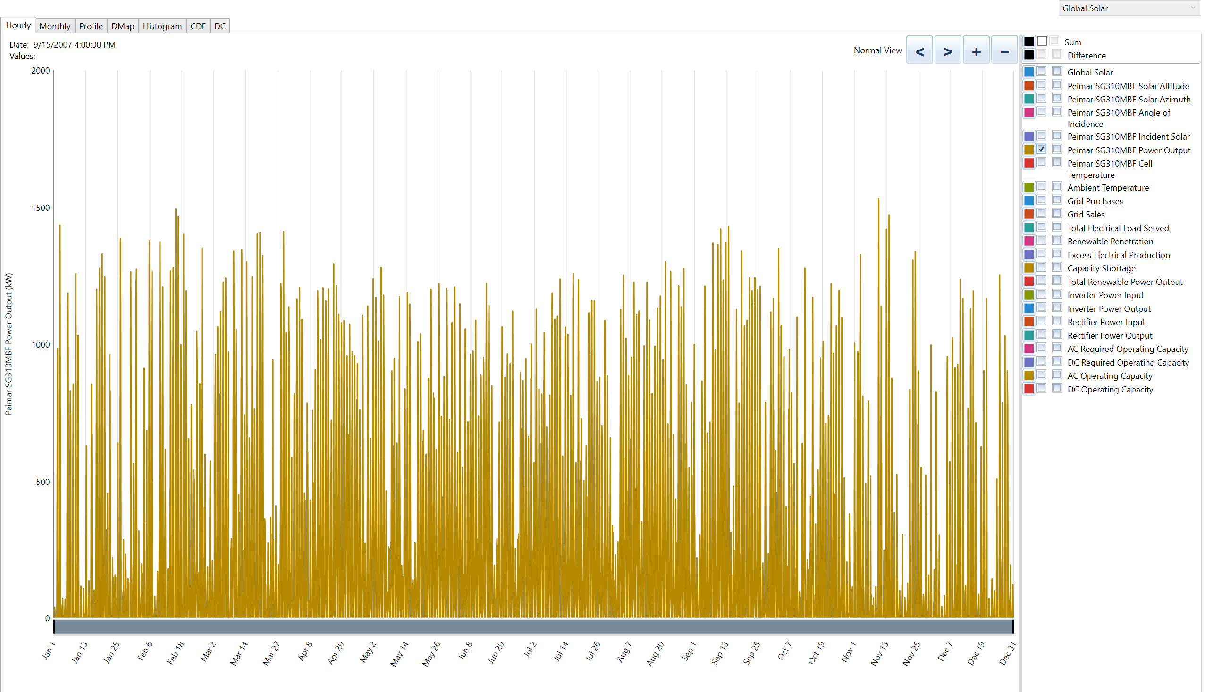
Notes:
All of this required a lot of data and assumptions:
We got the Solar data from HOMER and Retscreen and we chose our panels and electrical infrastructure based on advice from solar suppliers.

Slide 13
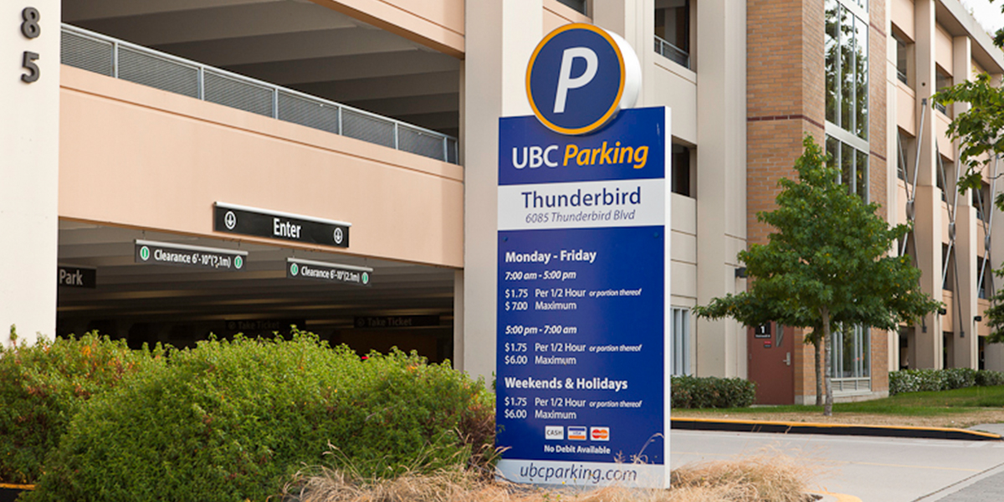
EV Usage
Notes:
We used real EV charging data from the 8 current EV chargers at Thunderbird and matched the patterns through the year for our model.

Slide 14
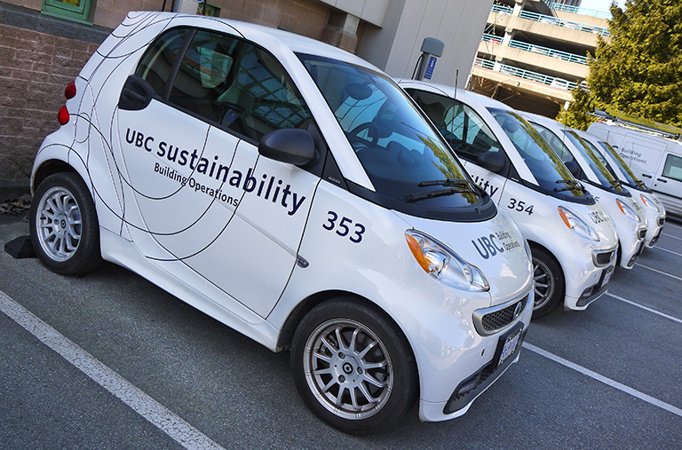
EV Usage
Notes:
And we grew the percentage of public EV vehicle adoption from local think tank estimates. And we had to make assumptions on how much the public would be willing to pay for EV Charging - something made legal in BC only a few weeks ago. And some assumptions on what is going to motivate people to move their cars once their charging is done.
AFTER CLICK: We used the EV vehicles in our current fleet as a starting point.

Slide 15
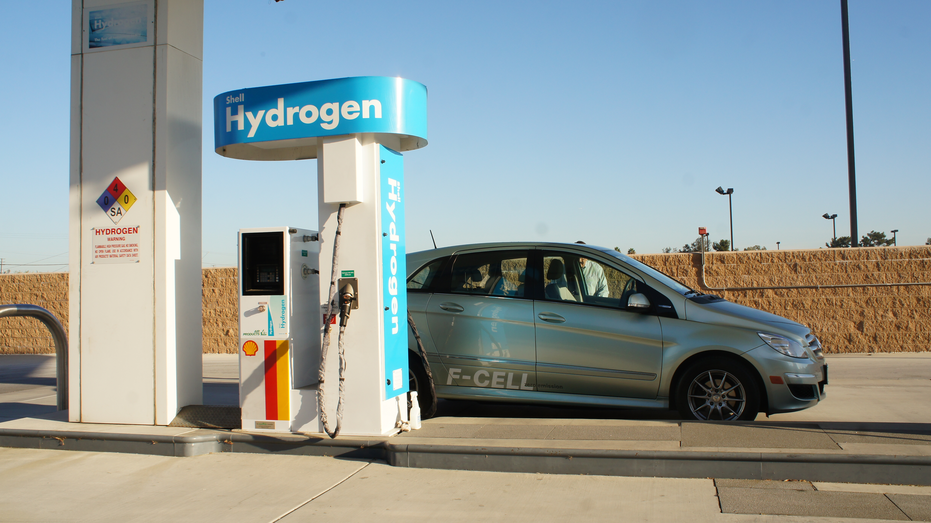
Hydrogen Usage
Notes:
We started out with a estimate of how many hydrogen vehicles they expect to be using at the university refueling station and grew the numbers with the industry prediction on the adoption of hydrogen.

Slide 16
Energy Storage
Notes:
We did analysis on how much energy storage would actually be useful for our project, can it reduce our peak demands and when should it be charged.

Slide 17
Component Efficiency
η = 68%
η = 89%
η = 89%
η = 98%
η = 19%
η = 98%
η = 99%
Notes:
Efficiencies of each component - IRENA , Homer, Hydrogenics,

Slide 18
Demand & Energy Charge
Notes:
The University has special rates through a PPA with the local energy utility for energy and demand charges. We used this data to model in the savings we could incur by demand charge reduction in peak times.

Slide 19
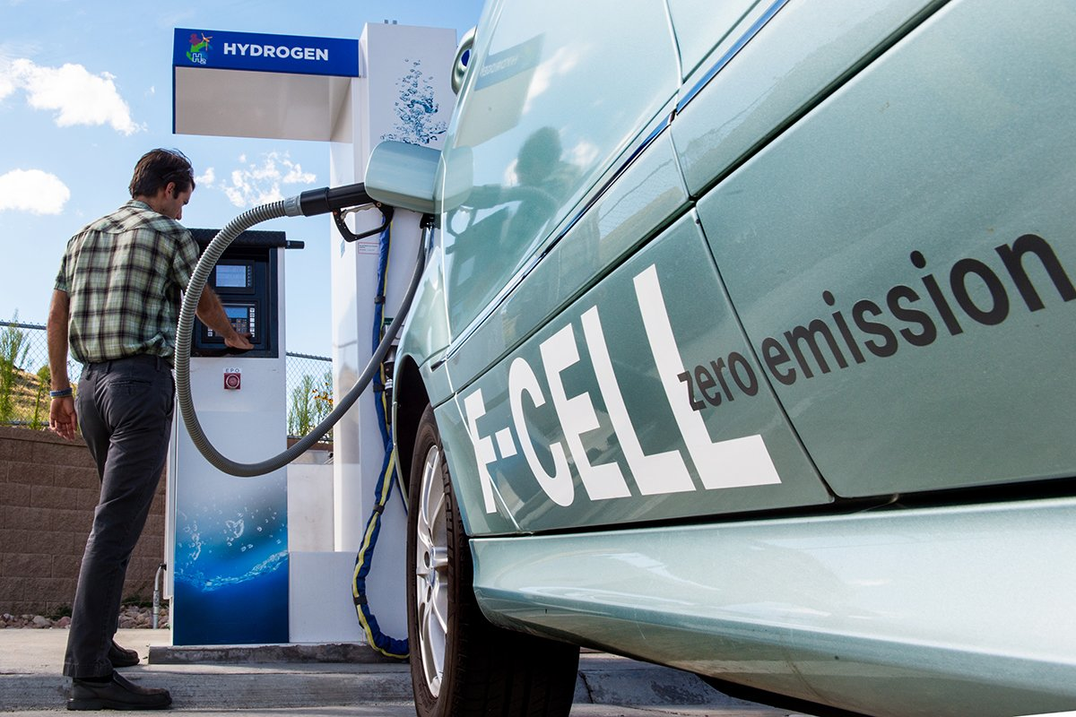
Low Carbon Fuel Standard
Notes:
We get Low Carbon Fuel Credits for producing and selling hydrogen. This is a relatively uncharted territory since the industry still makes hydrogen mainly from fossil fuels. We would be making it from water through electrolysis. The standards currently are currently only written to last up to 2040 so there's an assumption that it would only last until then.

Slide 20
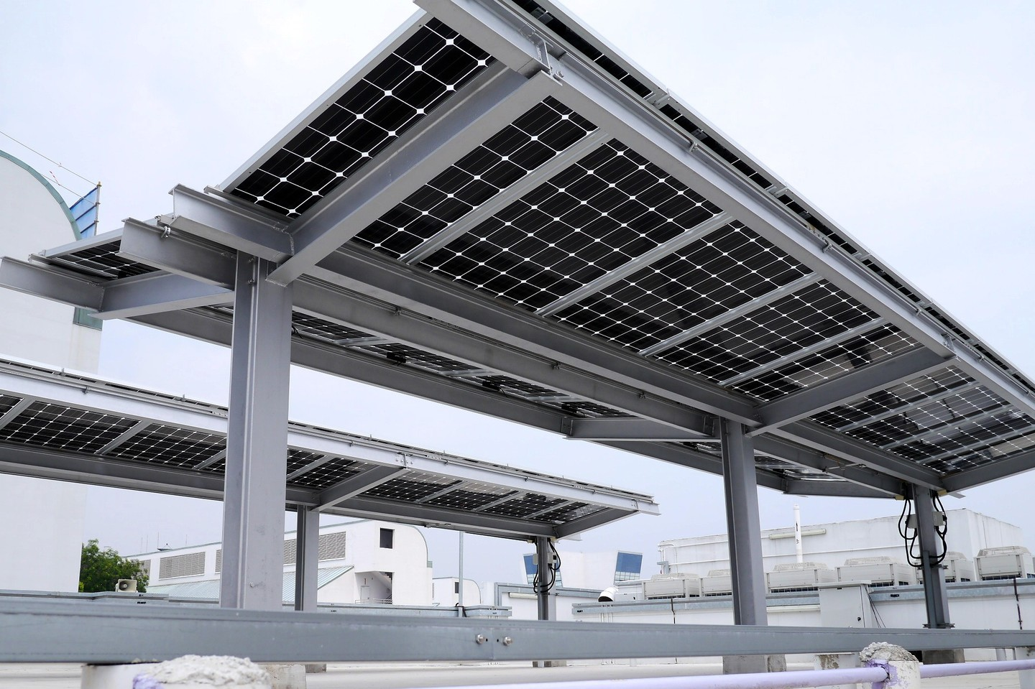
Capital Costs
Total: $8.7 million
Notes:
These are the major upfront capital costs of the project as shown here. The 3 most significant components were the solar panels, the superstructure and hydrogen infrastructure.

Slide 21
Equipment Lifespan
20yrs
10yrs
10yrs
10yrs
20yrs
10yrs
20yrs
Notes:
For replacement – we replace a percentage of our solar panels and our EV charging stations after 10 years. We do the same with our inverters, converters and hydrogen infrastructure.

Slide 22

Revenue Streams
PV OFFSET
EV CHARGING
GASOLINE OFFSET
LCFC H₂ STATION BUILD
LCFC H₂ GENERATION
HYDROGEN CHARGING
Notes:
- Since UBC is on its own grid, any excess energy we send back offsets energy we would have to buy from the grid. That’s a revenue stream.
- The BCUC has recently allowed EV station owners to charge users - That’s another revenue stream.
- Operating an EV is much cheaper than operating a gasoline vehicle. For our UBC fleet, switching over to EV vehicles – that’s another revenue stream.
This offset exists when we switch our fleet to hydrogen vehicles as well. We also get low carbon fuel credits for every kg of hydrogen produced and for building the station. That’s another revenue stream.
There will be a charge for hydrogen refueling - this is projected to decrease over the years from currently $12.75/kg to a possible $6/kg in the future. But that’s another revenue stream.

Slide 23
Financial Data
BC Hydro
Escalation Rate
6%
2%
3%
Discount Rate
Inflation Rate
Notes:
We used industry standard numbers for these financial rates for building yearly cash flows and performing a net present value analysis to find out - does the project make financial sense?

Slide 24
NPV Analysis – Initial
-$7.2 million!
Notes:
We did all the analysis and net present value of our UBC model is … negative 7.2 million dollars!
So we obviously had to do some optimization

Slide 25
NPV Analysis – Sensitivity
Notes:
First we performed a sensitivity analysis to find which knobs we could tweak to adjust the model.
For example, we saw the model is sensitive to the electricity cost and the cost of EV charging.

Slide 26
NPV Analysis – Business Model Iteration
Notes:
We started out by tweaking the charger mix as we expand the EV charging network from the very expensive Level 3 fast chargers to the more conservative level 2’s, that both are cheaper to install and also reduce peak load. That increased our NPV by $1.5m.
When it came time for replacing our 100kg/day hydrogen facility, we looked into expanding to a 500kg/day facility – we scrapped that plan maintaining production at 100kg/day as this met our predicted needs and increased our NPV by $6.6m.
Then we looked at our energy storage and what could be done about peak shaving our demand charge. When scaling up our energy storage to 3MWh, we achieved significant gains in our NPV. Technically, we could go up all the way to a 50MWh energy storage facility, but that takes up a lot of room.

Slide 27
NPV Analysis – Peak Shaving
Notes:
By implementing peak shaving, we could save up to $740k in our NPV due to reduction in peak demand charges.

Slide 28
NPV Analysis – UBC Optimized
$1.6 million
Notes:
With these modifications, our model at UBC now has a NPV of $1,600,000.

Slide 29
NPV Analysis – City of Vancouver Model
$1.8 million
Notes:
As we move to implement this microgrid in the city, we looked at the components that make financial sense and those that don’t. We ended up removing the hydrogen component and that improved our NPV to $1.8m.

Slide 30
NPV Analysis – Warehouse Model
$4.0 million
Notes:
Better yet, we did a model without the superstructure needed for a solar canopy – that’s straight solar on top of an industrial building with EV charging at the parking lots. This further improved the NPV to $4m.

Slide 31
Energy Split
Notes:
Over time, this is how the share of solar energy changes as we continue to draw more energy from grid due to limited solar generation capacity. We see the largest energy consumer over time is EV charging due to the expansion of number of chargers.

Slide 32
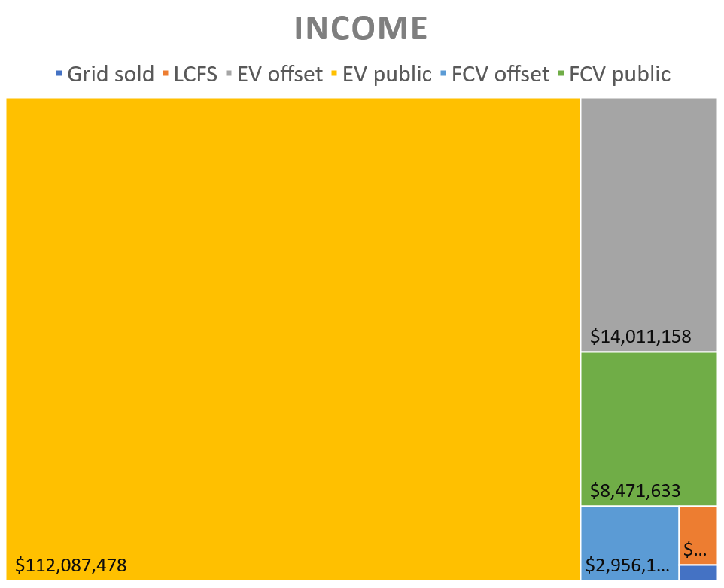
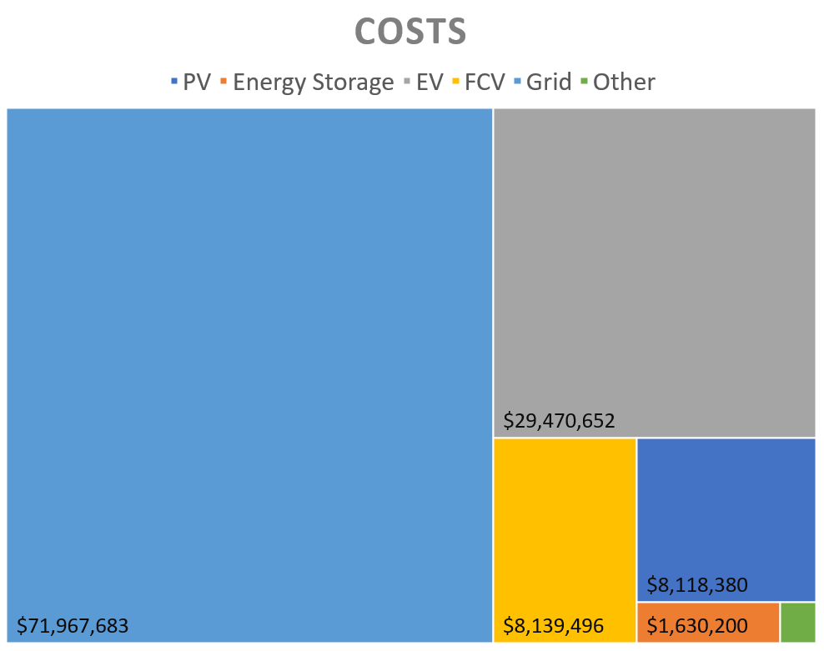
Costs & Income
Notes:
Not surprisingly, over the lifetime of the project, the grid expenses are the lions share followed by the cost of installing and replacing EV chargers. Our income on the other hand is primarily from charging EV vehicles.

Slide 33
CO₂ Avoided
Notes:
By the end of year 40 we could be saving 115,000 tons of CO2 per year from not burning fossil fuels for transportation.

Slide 34
Conclusions
PV SELLBACK TO GRID
EV CHARGING
GASOLINE OFFSET
LCFC H₂ STATION BUILD
LCFC H₂ REFUELLING
HYDROGEN CHARGING
Notes:
In conclusion, we found the model is highly sensitive to EV charging costs. And while we have market predictions we based our model on, its hard to know what the market and consumers will decide is a fair price to charge Electric vehicles.

Slide 35
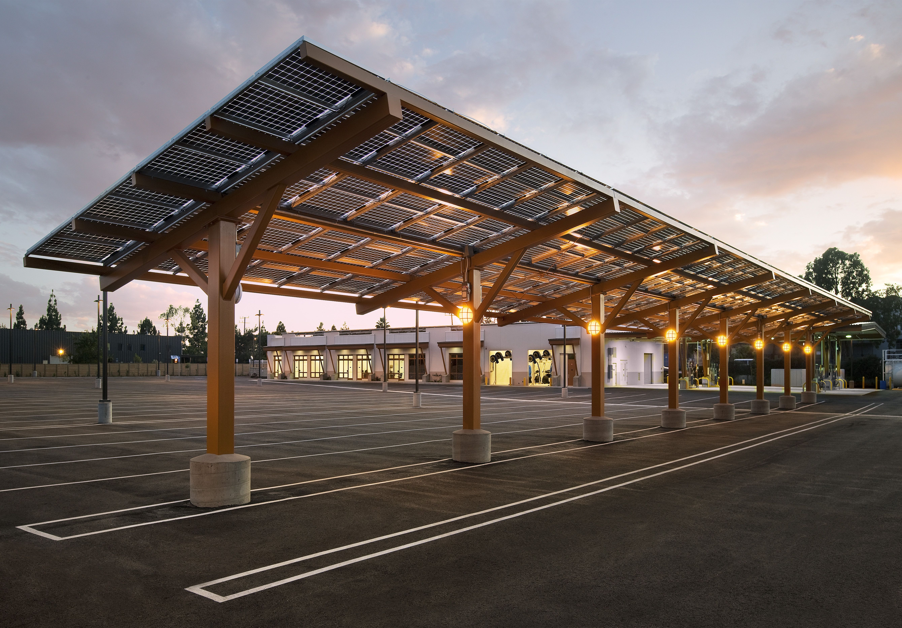
Conclusions
Notes:
Also, don't build a super structure if you don’t have to because it’s a big capital investment. There are plenty of empty rooftops that can be used for solar and a lot of top floors of parkades are rarely used.

Slide 36
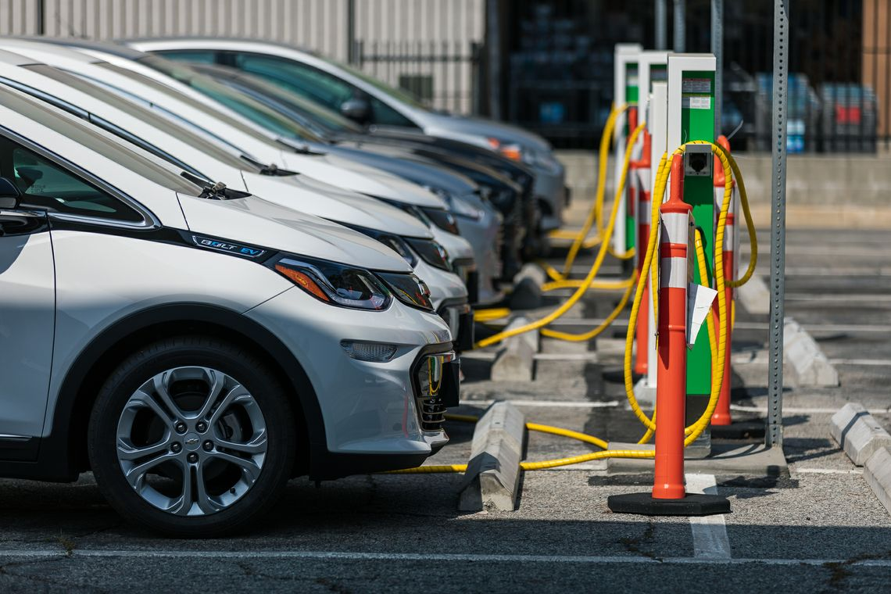
Conclusions
Notes:
And finally, organizations with fleets should consider electrifying their fleets and developing EV charging stations for daytime revenue from the public. Their fleets can then be charged at night. If it can make sense in an academic setting with research components like hydrogen production and DC charging, it shows promise for various other scenarios.
Thank you

Slide 37
Thank you
CCSTT:
M.K. Anand
Balpreet Kukreja
Bernardo Ruz
A Business Case for Microgrids with Solar to EV Charging

Slide 38
Monthly Energy Split

Slide 39
Yearly Energy Split

Slide 40
Costs & Incomes

Slide 41
H2 production cost vs charging fee

Slide 42
Gasoline & Electricity Prices

Slide 43
Sensitivity Analysis

Slide 44
Solar Data

Slide 45
Energy Storage Analysis

Slide 46
Avoided CO2e

Slide 47
Optimization

Slide 48
Peak shaving

Slide 49
Peak shaving

Slide 50
Sources
Data | Value | Source
PV voltage | 1 000 V | http://solarenergy.advanced-energy.com/upload/File/Application%20Notes/ENG-600vor1000V-260-02.pdf
PV capital cost | CA$ 3.8 /W inst. | SPCC research
ES output efficiency | 99% | https://batteryuniversity.com/learn/article/comparing_the_battery_with_other_power_sources
ES capital cost | US$ 209 /kWh
ES degradation rate | 30% every 10 years
EV efficiency | 0.175 kWh / km | https://pushevs.com/2016/11/23/electric-cars-range-efficiency-comparison/
EV charging station lifetime | 10 years
EV 7.4 kW capital cost | CA$ 13 889 /unit | Charge point
EV 62.5 kW capital cost | CA$ 52 378 /unit | Charge point
EV 125 kW capital cost | CA$ 96 566 /unit | Charge point
Electrolyzer energy input | 5.2 kWh/Nm3 H2 | Hydrogenics
Compressor energy input | 2.7 kWh/kg | H2 CSD technical status and costs (energy.gov)
Storage capital cost | US$ 242 500 | H2 CSD technical status and costs (energy.gov)
Dispenser capital cost | US$ 200 500 | H2 CSD technical status and costs (energy.gov)
100 kg electrolyzer capital cost | US$ 321 205 | Current Forecourt Hydrogen Production from PEM Electrolysis (energy.gov)
H2 compression, storage & cooling unit | CA$ Disclosed | RFP

Slide 51
Sources
Data | Value | Source
H2 CSD O&M costs | US$ 0.54 / kg | Electrolyzer O&M costs report
Electrolyzer O&M costs | US$ 0.4 / kg | Electrolyzer O&M costs report
H2 vehicle capacity | 5 kg | https://www.toyota-europe.com/download/cms/euen/13096%20MIR_40_MAST_WEB_tcm-11-1150380.pdf
H2 truck capacity | 40 kg | https://www.forbes.com/sites/markewing/2017/08/09/toyotas-hydrogen-fuel-cell-kenworth-can-revolutionize-heavy-transport/#13f99a776e48
H2 compressor lifetime | 10 years | H2 CSD technical status and costs (energy.gov)
H2 storage lifetime | 30 years | H2 CSD technical status and costs (energy.gov)
H2 dispenser lifetime | 10 years | H2 CSD technical status and costs (energy.gov)
H2 electrolyzer lifetime | 20 years | Electrolyzer O&M costs report
LCFS | 0.0245 credits / kg | https://www2.gov.bc.ca/assets/gov/farming-natural-resources-and-industry/electricity-alternative-energy/transportation/renewable-low-carbon-fuels/pathway_assessment_2017.pdf
Cost of credit | CA$ 163.9 / credit | https://www2.gov.bc.ca/assets/gov/farming-natural-resources-and-industry/electricity-alternative-energy/transportation/renewable-low-carbon-fuels/pathway_assessment_2017.pdf
Electrolyzer voltage | 3 x 480 V | Hydrogenics
Compressor voltage | 480 V | RFP
Mileage gasoline vehicles | 25 km / kg | https://www.forbes.com/sites/lauriewinkless/2016/06/01/are-hydrogen-fuel-cell-cars-becoming-normal/#894d77a683a0

Slide 52
Sources
Data | Value | Source
Mileage H2 vehicles | 100 km / kg | https://www.forbes.com/sites/lauriewinkless/2016/06/01/are-hydrogen-fuel-cell-cars-becoming-normal/#894d77a683a0
Price of gasoline | CA$ 1.51 / liter | https://www.expatistan.com/price/gas/vancouver
Gasoline escalation | Forecast | https://www150.statcan.gc.ca/t1/tbl1/en/cv.action?pid=1810000101#timeframe
H2 charging fee | CA$ 12.75 / kg | Shell charging station
Transformer & inverter efficiency | 98% | http://pgembeddedsystems.com/securelogin/upload/project/IEEE/41/PG2013PE0026/Copy%20(4)%20of%20ok%20(2).pdf
Discount rate | 6% | https://pdfs.semanticscholar.org/5638/1456a69973e99369f9079cb8f6bab9d25952.pdf
Inflation rate | 2% | https://pdfs.semanticscholar.org/5638/1456a69973e99369f9079cb8f6bab9d25952.pdf
EV adoption rate year 1 | 27.5% | https://www.fleetcarma.com/electric-vehicle-sales-canada-2017/
EV charging fee year 1 | CA$ 0.35 / kWh | https://pluginbc.ca/charging-stations/public-charging/
FCV adoption rate year 1 | 60% | https://www.statista.com/statistics/644545/global-sales-of-fuel-cell-vehicles/

