Slide 1

The Relative Inefficiency of Petroleum Taxation in Latin America and the Caribbean
Graham A. Davis
Division of Economics and Business
Colorado School of Mines
James L. Smith
Dept. of Finance
Southern Methodist University
IAEE, June 1, 2019
Montreal, Canada
Notes:
This is a simple paper, one that I have been working on for far too long. I started it in 2001, when I first read of claims of high income inequality in mining and oil economies. Having lived and worked in Namibia, the most unequal economy in the world, the proposition seemed strange, since my casual observations about mining in Namibia would have led me to the opposite conclusion, that mining activity decreased income inequality. But economists are trained to base our analyses on data, and so I began to connect gini data for mining and oil economies that was starting to be published by the World Bank. It became readily apparent that the data was just not there for many of these economies, and so I wrote up a short working paper and left it at that.
I want to see what impressions you have on this topic:

Slide 2
Study Background
$550,000 study commissioned by the Canadian Extractive Sector Facility (CANEF) in 2016 to “help LAC countries move toward more responsive, flexible, and transparent fiscal regimes in the EIs”
Inter-American Development Bank (IDB) was project lead
Davis (mining) and Smith (petroleum) were PI’s
Report submitted to IDB for production in May, 2019
Notes:
Let me show you just how sparse the data is:

Slide 3

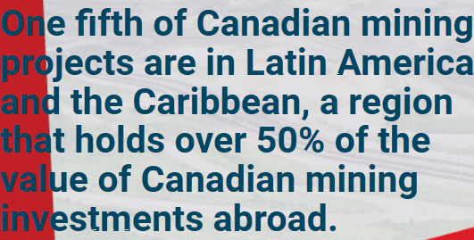
Study Background
Notes:
Let me show you just how sparse the data is:

Slide 4
Method
Engineering-economic model of projects as in Smith (Energy Economics, 2014), with appropriate modifications for mining
Expose hypothetical country petroleum projects and actual mining projects, assuming initiation in 2018, to the fiscal regimes in place in that country in 2018
Optimize investment and operating decisions both without taxation and with taxation, and observe differences
Calculate government take, DWL, fiscal yield, and fiscal inefficiency
Notes:
Let me show you just how sparse the data is:

Slide 5
Method
Examined both full-cycle (exploration stage) and half-cycle (post-exploration) projects
Notes:
Let me show you just how sparse the data is:

Slide 6
Study Sample
Notes:
Let me show you just how sparse the data is:

Slide 7
Study Sample (Petroleum)
Notes:
Let me show you just how sparse the data is:

Slide 8
Observation #1
The fiscal regimes for mining are very different than for petroleum, even within the same country
  Petroleum taxation is more aggressive
  Petroleum relies much more heavily on royalties
  There is no production sharing in mining
Notes:
Let me show you just how sparse the data is:

Slide 9
Observation #2
None of the fiscal regimes attempt neutral taxation (such as via cash flow taxes, rent taxes)
As a result, they are all distortionary of project investment and operating decisions
Royalties are particularly distortionary
Notes:
Let me show you just how sparse the data is:

Slide 10
Example: Full-Cycle Ecuador Offshore Gas with Sliding-scale PSC
Notes:
Let me show you just how sparse the data is:

Slide 11
Observation #3
Petroleum projects are generally distorted to a higher degree than mining projects both as a result of higher rates of resource taxation and the use of inefficient fiscal instruments
Notes:
Let me show you just how sparse the data is:

Slide 12
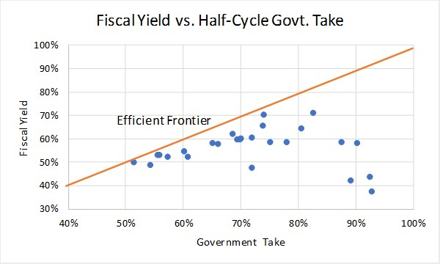
Observation #3 (continued)
In some cases petroleum taxation is so high as to diminish government revenues
Notes:
Let me show you just how sparse the data is:

Slide 13
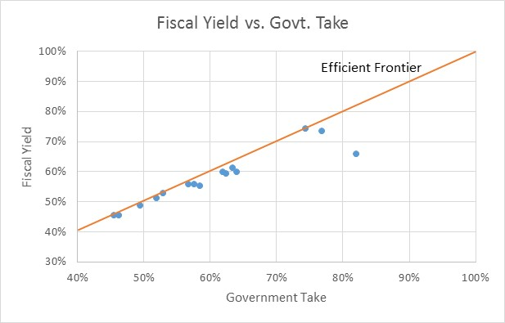
Observation #3 (continued)
Compare this with mining
Notes:
Let me show you just how sparse the data is:

Slide 14
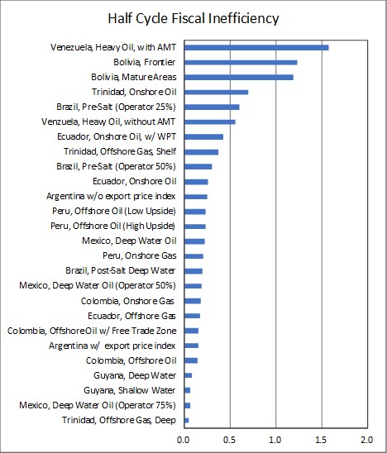
Observation #3 (continued)
Notes:
Let me show you just how sparse the data is:

Slide 15
Observation #4
The effect of taxation is highly project dependent
Because of regressivity and progressivity of these systems, project margin matters
Different projects have different flexibilities to avoid taxation – some projects are rigid and are inelastic to taxation, while others are elastic
It would be unwise to assess the fiscal performance of different regimes by passing them through a “representative project”
Notes:
Let me show you just how sparse the data is:

Slide 16
Recommendations (in order of political ease)
Government Take is a poor measure of fiscal performance (it can be high, but fiscal yield low). Use Fiscal Yield instead (requires project modeling).
Reduce tax rates when Government Take is > ~70% (win-win situations are possible)
Reduce reliance on royalties, increase reliance on income surtaxes with expensing of tangibles and intangibles (do not restrict loss carryforwards)
Look to implementing neutral taxation schemes (Norway is an example)
Notes:
Let me show you just how sparse the data is:

Slide 17
Recommendations (in order of political ease)
Broaden the tax base: petroleum taxation relatively inefficient compared with mining taxation, GST, PIT, and CIT in other sectors – motivates reducing petroleum tax in favor of a broader tax base
Notes:
Let me show you just how sparse the data is:

